Slide 1




Sheffield Family Hubs

Slide 2
Sheffield Family Hubs
​
Family Hubs are warm and welcoming spaces
We deliver activities for children aged 0-5 and offer help, signposting & support to parents/carers of children aged 0-19 or up to 25 for those with SEND.
Sheffield Family Hubs | Sheffield
2
Sheffield City Council

Slide 3
Family Hubs aim to
More accessible – Families understand they can access support at a local Family Hub, virtually or out in their community.
Better connected – Family Hubs and Family Hub Network Members connect various services and professionals to support families with diverse needs. They offer early help for the whole family, reduce service gaps and improve efficiency.
More relationship-centred – practice in a Family Hub focuses on building trusting and supportive relationships, emphasising continuity of care in the Start for Life offer. It builds on families’ strengths, drawing on and improving relationships, including building networks with peers to address underlying issues.
3
Sheffield City Council

Slide 4
Where are we?
An organisation can be one or more of these
There are 7 Family Hubs (and 5 linked sites) across the city which together with Community venues, outreach sites and network centres, cover all areas of Sheffield.
Anyone living in Sheffield can access any of the Family Hubs they don’t need to live in their locality.
Family Hub General opening hours Mon – Fri 8.30am- 4.30pm
4
Sheffield City Council

Slide 5
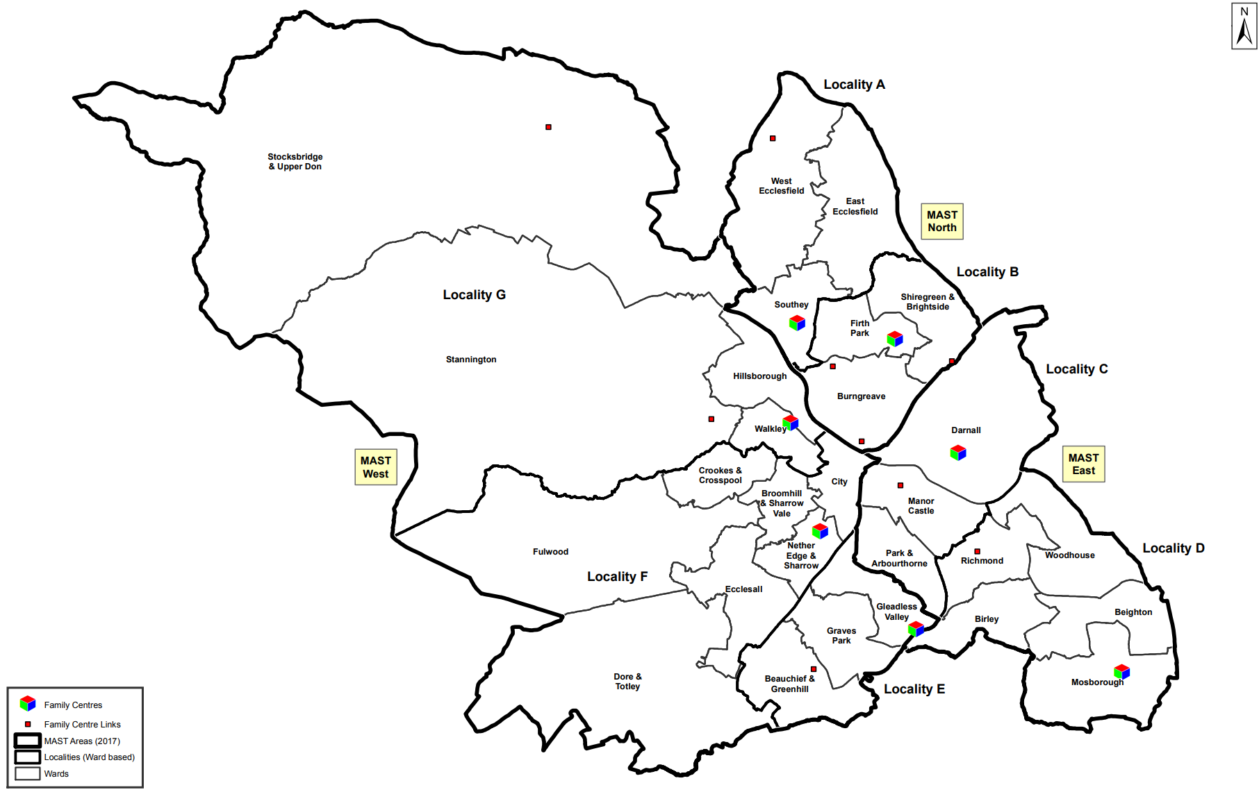
Map of Family Hub Locations
Notes:
Family Hubs

Slide 6
Family Hub Locations
Early Days Family Hub, 71 Palgrave Road, Sheffield, S5 8GS (Linked site: Angram Bank Centre)
First Start Family Hub, 441 Firth Park Road, Sheffield, S5 6HH (Linked sites: The Meadow, Burngreave Centre & Brightside Centre)
Darnall Family Hub, 563 Staniforth Road, Sheffield, S9 4RA (Linked sites: Wybourn Centre)
Shortbrook Family Hub, First Floor Shortbrook Primary School Site, Westfield Northway, Sheffield, S20 8FB
Sharrow Family Hub, Second Floor, Highfield Library, London Road, Sheffield, S2 4NF
Valley Park Family Hub, Bankwood Close, Sheffield, S14 1LW (Linked site Lowedges Community Centre)
Primrose Family Hub, Creswick Street, Sheffield, S6 2TN (Linked site Stocksbridge Centre)
An organisation can be one or more of these
6
Sheffield City Council

Slide 7
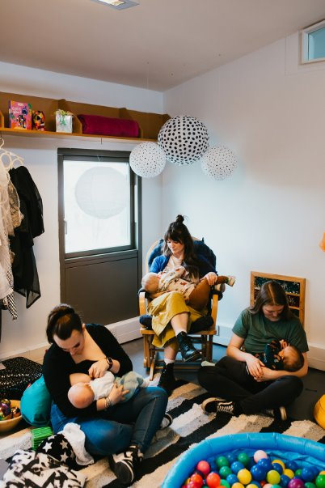
What do Family Hubs Offer
Find out what's on here: What's on | Sheffield (sheffielddirectory.org.uk)
Infant Feeding Advice & Guidance
Doula Service
Baby Showers
Preparation for Birth and Beyond
Baby Groups
Baby Massage
Sensory Rooms available to book for FREE!
Breastfeeding Groups
Walk and Talk Group
Weaning Advice Sessions
1:1 Prevention Work
An organisation can be one or more of these
7
Sheffield City Council

Slide 8
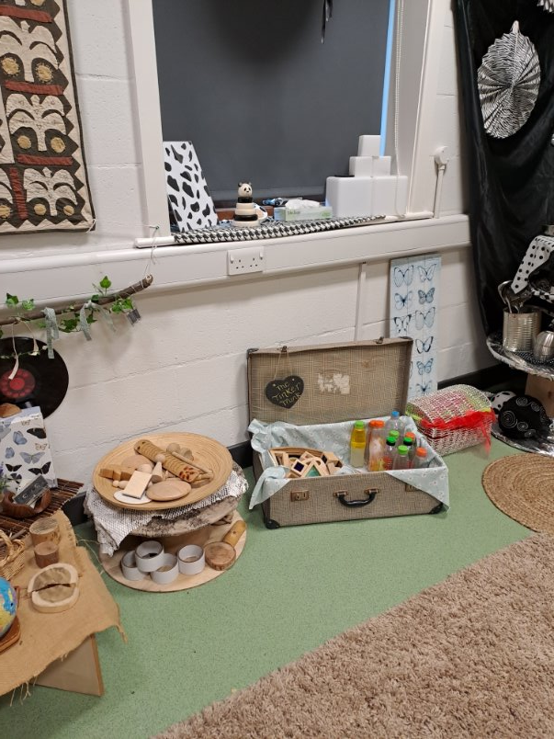
What do Family Hubs Offer
Find out what's on here: What's on | Sheffield (sheffielddirectory.org.uk)
Toddler groups and Workshops
Play, Chat and Learn Workshops
Early Language and Home and Family Learning activities
Sensory Rooms available to book for FREE!
Toilet Training and Dump the Dummy advice sessions
Holiday Activities
Support Accessing Funded Early Learning
Coffee Mornings
An organisation can be one or more of these
8
Sheffield City Council

Slide 9
What do Family Hubs offer
Additional Information and Services
Health Visiting Health Visiting | Sheffield
Midwifery ServicesMaternity and pregnancy | Sheffield
Healthy Start Scheme includes free and low cost vitamins as well as money to buy healthy food and milk www.healthystart.nhs.uk
Start Well Programme Start Well Sheffield Family Programme | Sheffield
Parenting Programmes Sheffield Parent Hub | Sheffield sheffielddirectory.org.uk)
Funded Early Learning Funded Early Learning | Sheffield
Cost of living support Help with the cost of living | Sheffield
Sleep Clinics Sleep Service - Sheffield Children’s NHS Foundation Trust
Contraception Services Contraception Service | Sexual Health Sheffield - Meeting Your Sexual Health Needs
Please use and promote the Sheffield Directory and Family Hub booklet
Children and Families | Sheffield (sheffielddirectory.org.uk)
Sheffield Family Hubs | Sheffield
An organisation can be one or more of these
9
Sheffield City Council

Slide 10
What do Family Hubs offer
Additional Information and Services
Links to specialist services such as
Shelter Shelter services in Sheffield - Shelter England
DWP Department for Work and Pensions - GOV.UK:
SEND Sheffield SEND Information and Advice Service (SSENDIAS) | Sheffield City Council
Stop Smoking Smokefree Sheffield | Inspiring a smokefree generation in Sheffield,
Domestic Abuse Services IDAS
Alcohol and Substance Misuse Likewise
PAIRS and Perinatal Mental Health Parent and infant relationship service (PAIRS) - Resource Library - Sheffield Children's NHS Foundation Trust
Light Peer Support Home | Light Peer Support
Adult Mental Health Services Sheffield Primary and Community Mental Health Service | Sheffield Health and Social Care
Steel City Dads Steel City Dads - Zest
Talking Toddlers Talking Toddlers - Resource Library - Sheffield Children's NHS Foundation Trust
Family Learning About the Family, Adult and Community Education Service | Lifelong Learning and Skills
An organisation can be one or more of these
10
Sheffield City Council

Slide 11
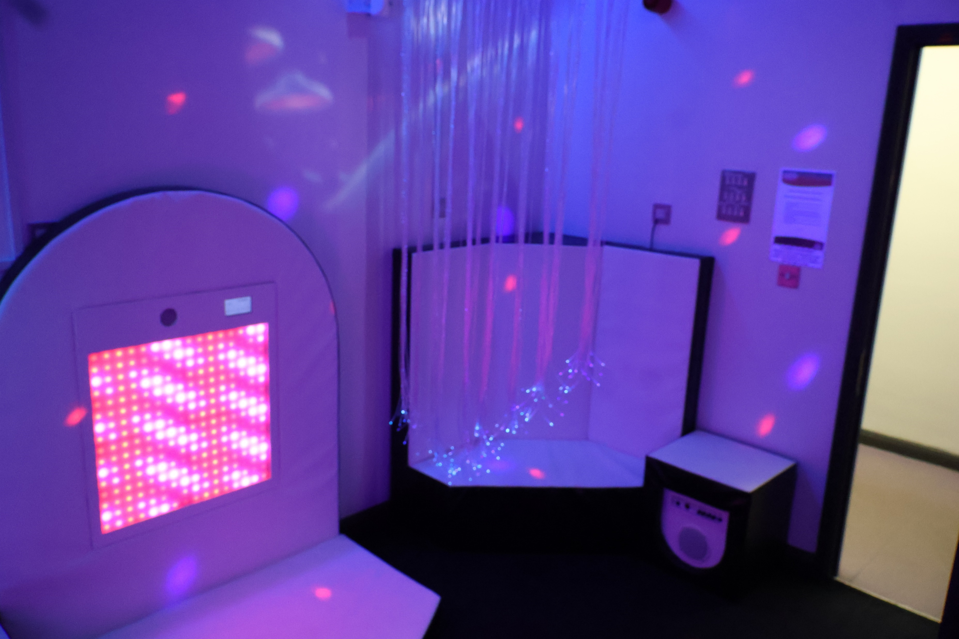
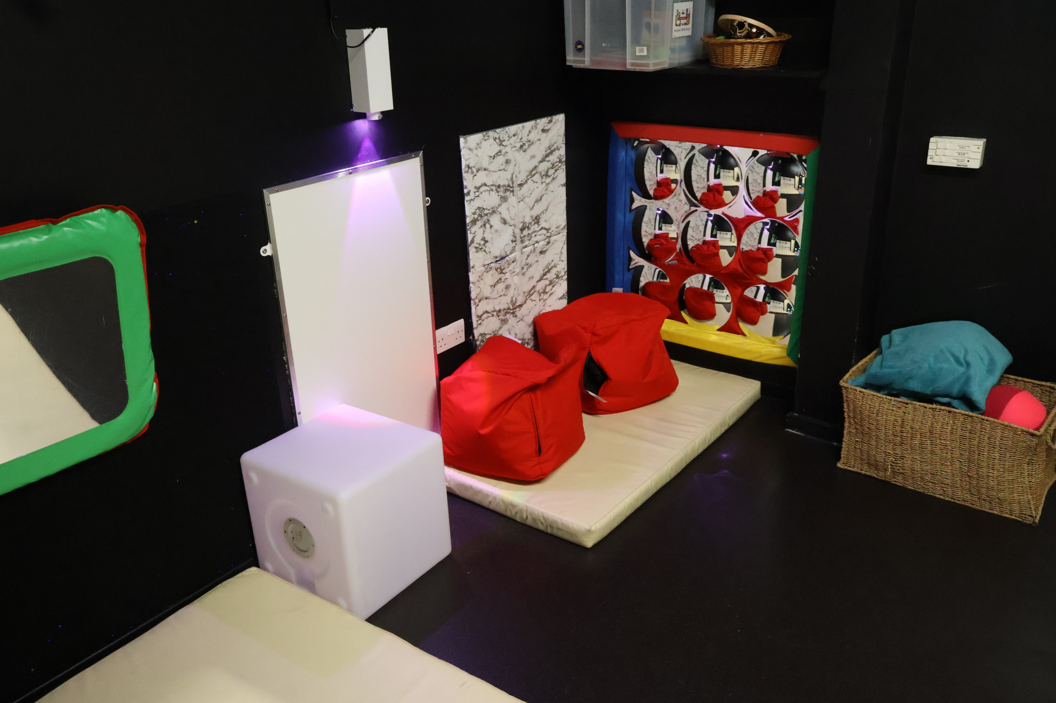
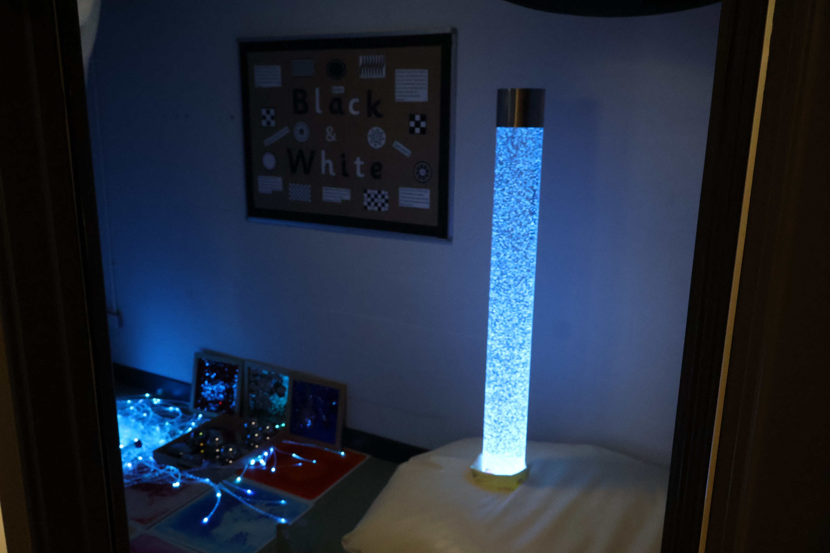
Sensory Rooms
An organisation can be one or more of these
We offer several free sensory rooms across the city
To book a Sensory Room please click on the link below
Family Hub Sensory Spaces | Sheffield
11
Sheffield City Council

Slide 12
Volunteer Opportunities
We offer several ways to volunteer these are:
Community Connectors
Empowering Parents Empowering communities
Doula
Infant Feeding Peer Support Volunteer
Volunteering with our Family Hub Network partners
If you wish to become a Volunteer, please follow the link below:
Family Hub volunteer opportunities | Sheffield
An organisation can be one or more of these
12
Sheffield City Council

Slide 13
Ways families feedback
Parent Carer Panel: Parents of children aged 0-2 can join our Parent Carer Panel and share their experiences of being a parent and accessing services, the views and experiences are then used in shaping and designing services.
Parent and Carer Panels | Sheffield
General Feedback: Parents and carers can give general feedback about their experience of Family Hubs these are circulated monthly on our social media pages.
Feedback Boxes: There are Feedback boxes in each of the Family Hubs and Community Network Sites. A simple yes/ no question to gather further feedback in volume on a variety of topics.
Activity Feedback: Parents who attend groups or activities will be asked regularly to complete Feedback forms (Questionnaires) which ask about things like satisfaction and experience.
Parent Representation on Governance meetings: There is opportunity for parents to take part in these.
An organisation can be one or more of these
13
Sheffield City Council

Slide 14
Professional Feedback
We also welcome feedback from professionals. You can do this by contacting your Locality Family Hub Co-Ordinator on the following numbers or by email at Sheffieldfamilyhubs@sheffield.gov.uk
Early Days 0114 273 4916
First Start 0114 203 9307
Darnall 0114 273 5008
Shortbrook 0114 205 3635
Sharrow 0114 205 3471
Valley Park No current telephone number
Primrose 0114 205 2723
Family Hubs Main Number 0114 2735665
An organisation can be one or more of these
14
Sheffield City Council

Slide 15
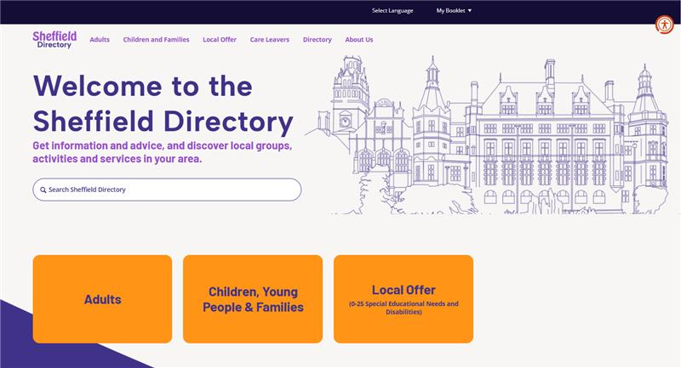
Sheffield Directory
An organisation can be one or more of these
_{Home Page | Sheffield}
15
Sheffield City Council

Slide 16
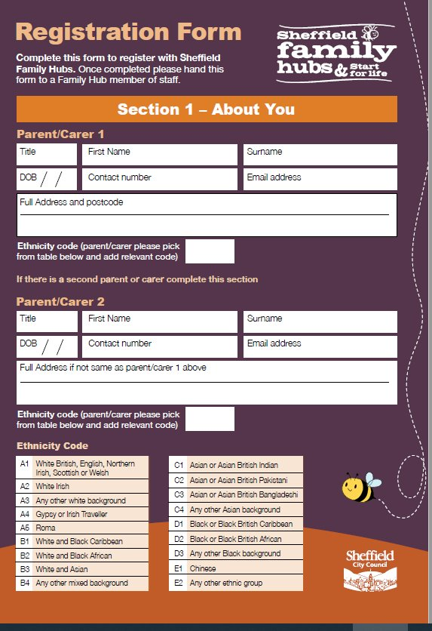
Family Hub Registration
An organisation can be one or more of these
We have recently reset FH registrations to be able to register families with children aged 0-19 or up to 25 with SEND as we were previously registering families with children aged 0-5 years.
Registering | Sheffield
16
Sheffield City Council

Slide 17
Registration benefits for families
We want families to:
Know about and understand the services on offer to them
Know where to go and who to ask to access services
Know there is a range of support available that is accessible in a way that works for them
Receive practical information early on preparing them in caring for their family
Feel empowered to get the support they may need at various stages of family life and make the right choices for their family
An organisation can be one or more of these
17
Sheffield City Council

Slide 18
Registration benefits for families
When a family registers, we will:
Send an informative welcome email.
Add them to the mailing list where they will receive regular updates on vital services
Keep them informed about upcoming events
Share information about the support available and signpost families to support if needed.
An organisation can be one or more of these
18
Sheffield City Council

Slide 19
Early Years Referral Process
Most activities and groups in Family Hubs are accessible without a professional referral, however if a Family needs a 1:1 support in the home or support to access services in the community you will need to complete an Early Help Assessment. This can be found at the bottom right hand side of the page in the link below:
How to contact your Early Help Hub | Sheffield
An organisation can be one or more of these
19
Sheffield City Council

Slide 20
Early Help Assessment
Multi-agency training and a video briefing are available
You can view the 12 minute briefing video here: https://www.youtube.com/watch?v=S4m9sa1hZgg
Multi-agency Training on Early Help Assessment skills is available via the Early Help Partnership Training offer Early Help Workforce Training | Sheffield
More information about the Early Help Assessment including guidance notes for completion and the Sheffield Threshold of Need guidance document is available here: Sheffield Children Safeguarding Partnership - Early Help, the Early Help Assessment & Thresholds of Need (safeguardingsheffieldchildren.org).
If you would like to request single-agency training on Early Help Assessment Skills for your organisation, please contact your link worker or link manager from the Family Intervention Service.
An organisation can be one or more of these
20
Sheffield City Council

Slide 21
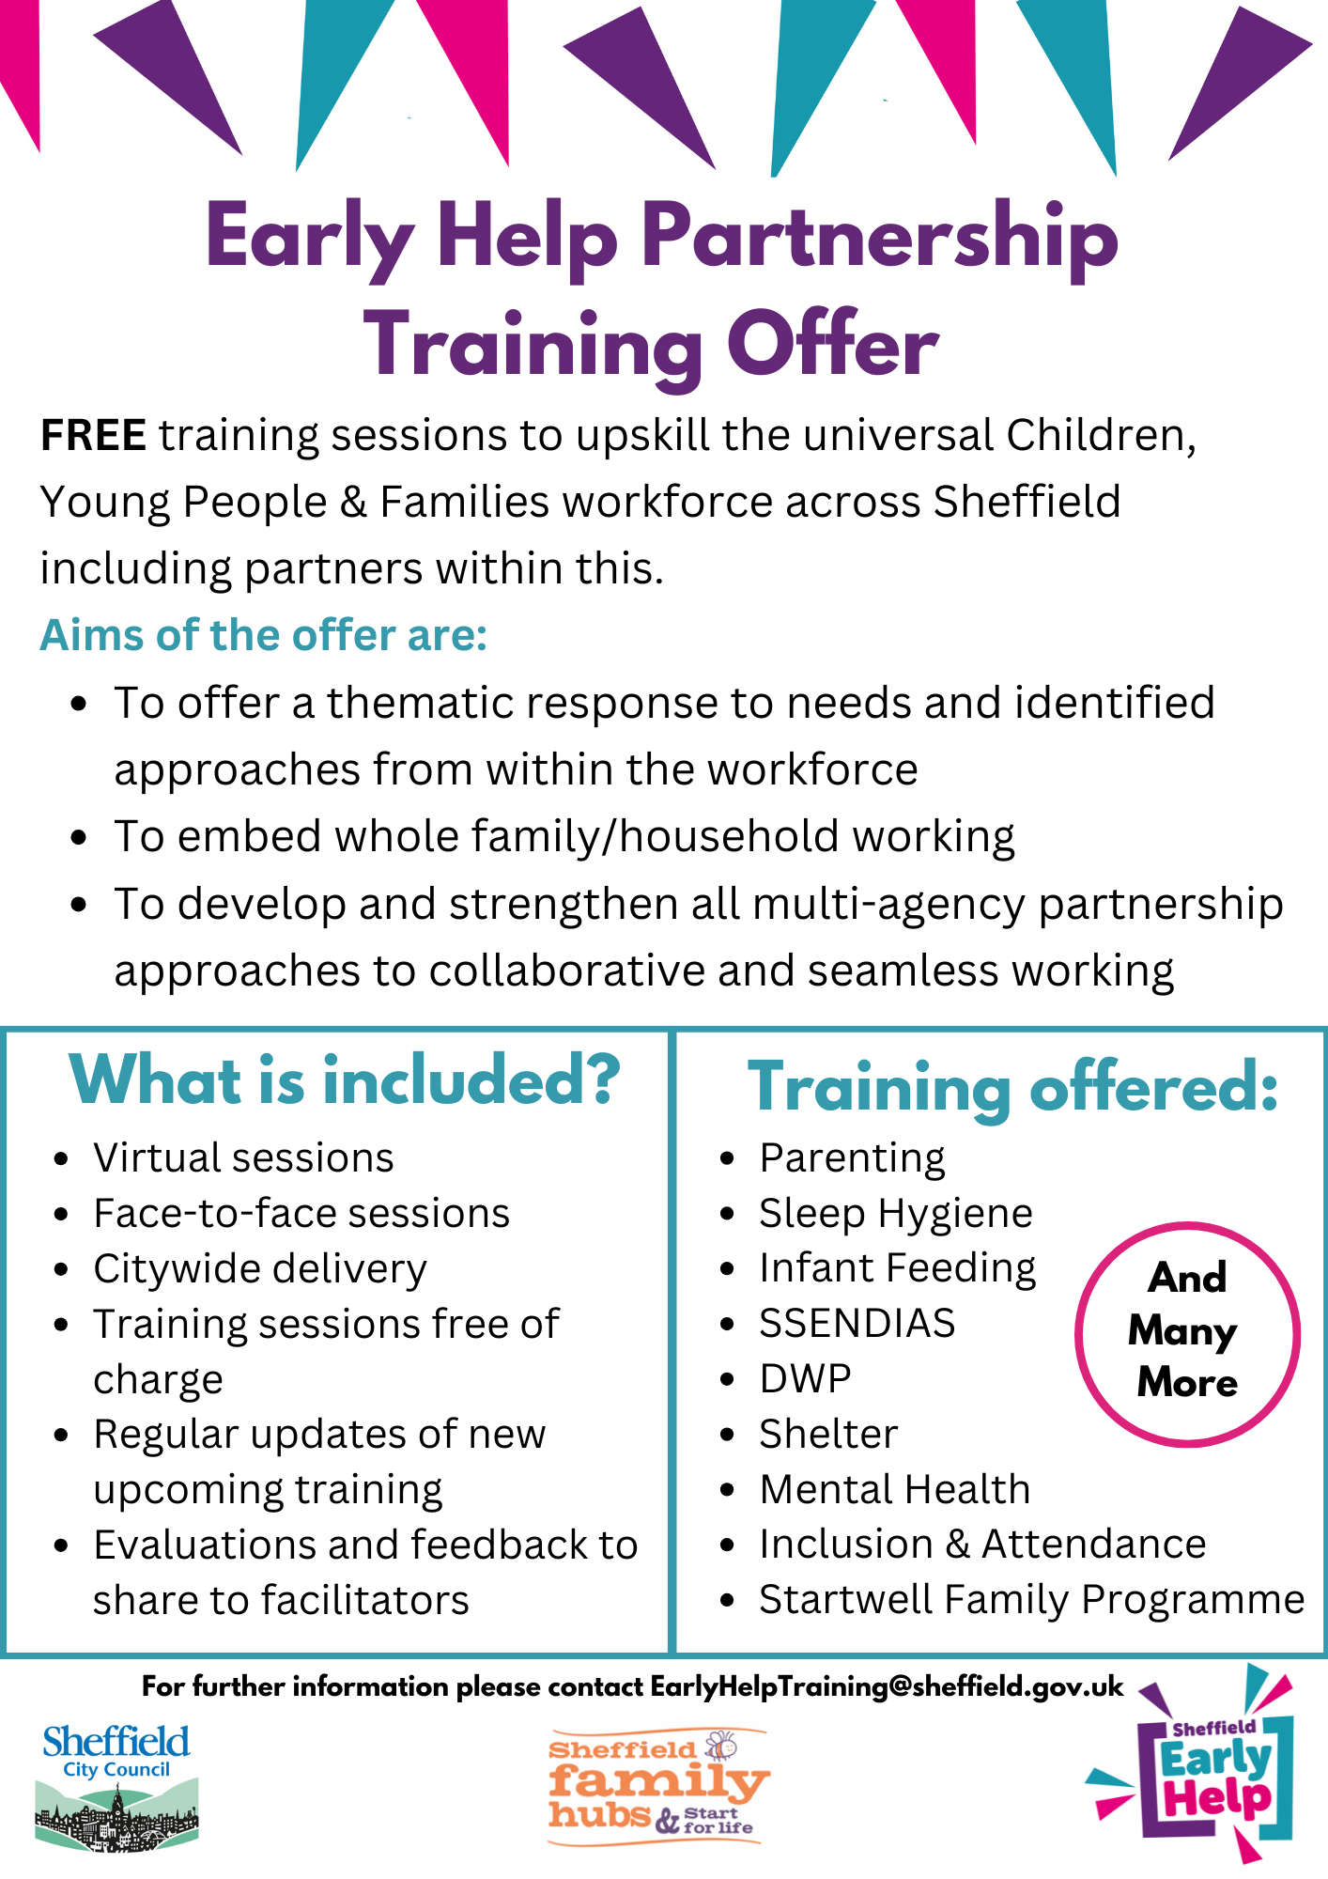
Early Help Partnerships Training Offer
An organisation can be one or more of these
To browse our training offer please follow the below link:
Early Help Partnership Training | Sheffield
21
Sheffield City Council

Slide 22
Family Hub Network
Strengthening connections between Early Years Providers, community partners and families
Promotion of Family Hub and Start for life offer (including each other!)
Working together we will deliver:
• Better connection across families and services
• The right information to families at the right time
• To meet family need at the earliest opportunity
• To work whole family, providing a seamless offer of support
If you would like to be part of our Family Hub Network please contact your local Family Hub and speak to the Family Hub Coordinator.
An organisation can be one or more of these
22
Sheffield City Council

Slide 23
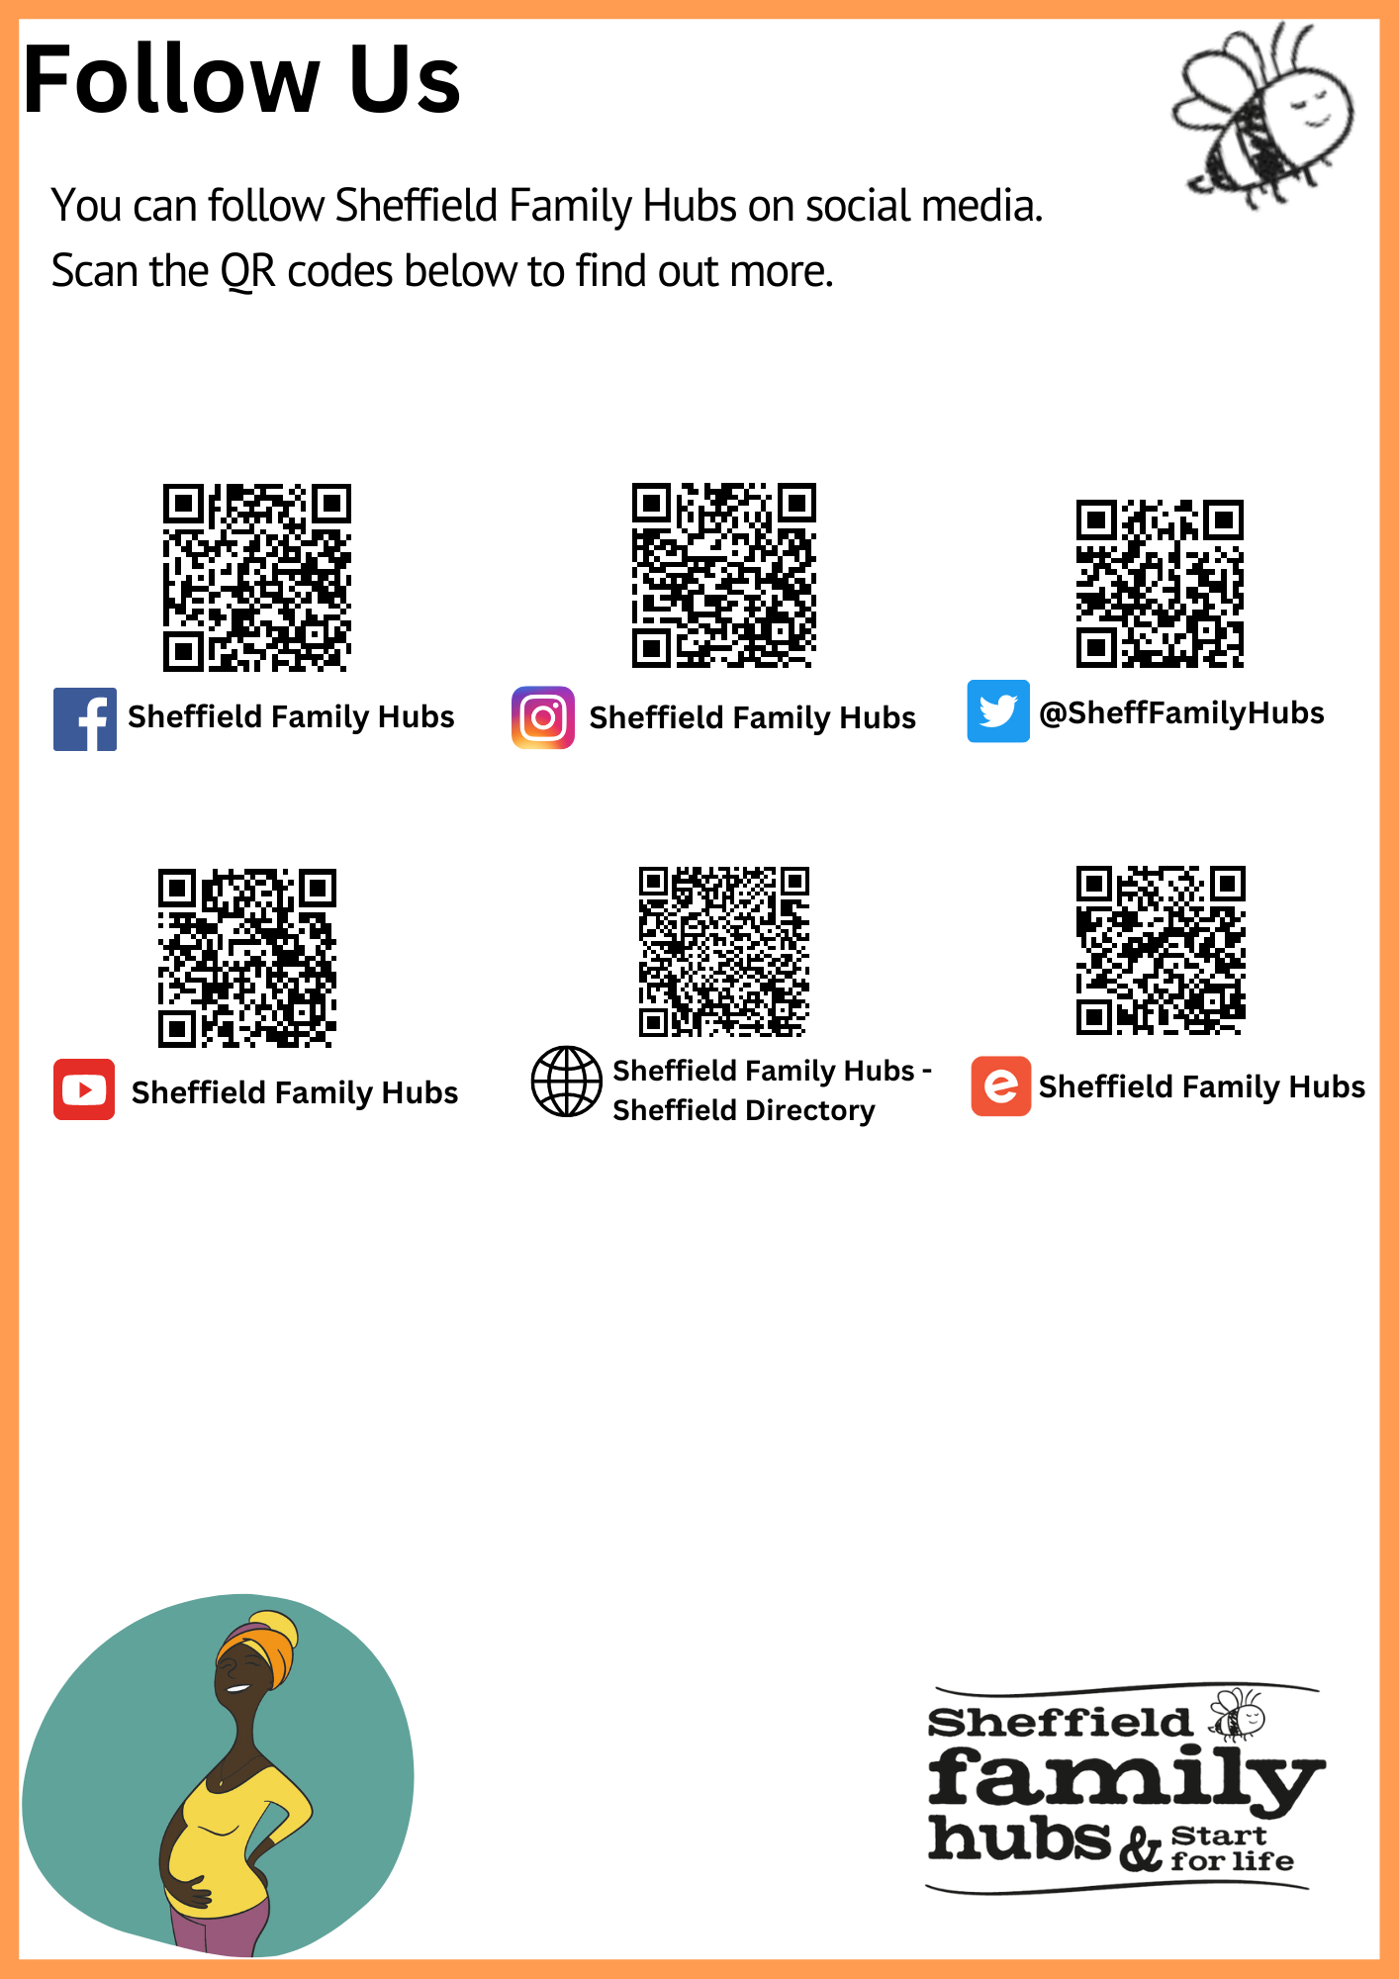
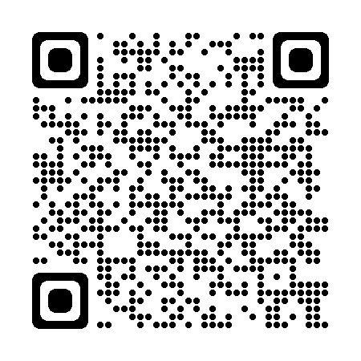
Social Media and Information links here
An organisation can be one or more of these
23
Sheffield City Council

Slide 24
An organisation can be one or more of these
Questions
24
Sheffield City Council

