Slide 1



How to Prepare for Adulthood with the Shared Lives Service
with the Shared Lives Service
06.05.26

Slide 2
Some Housekeeping
Today’s session will be recorded and shared with you following the event and hosted on our Local Offer website.
We’ll be monitoring the chat throughout – please share your questions or even just say hello! But please do not share any sensitive or personal information.
We will finish on or before 1:30pm.
2
Sheffield City Council

Slide 3
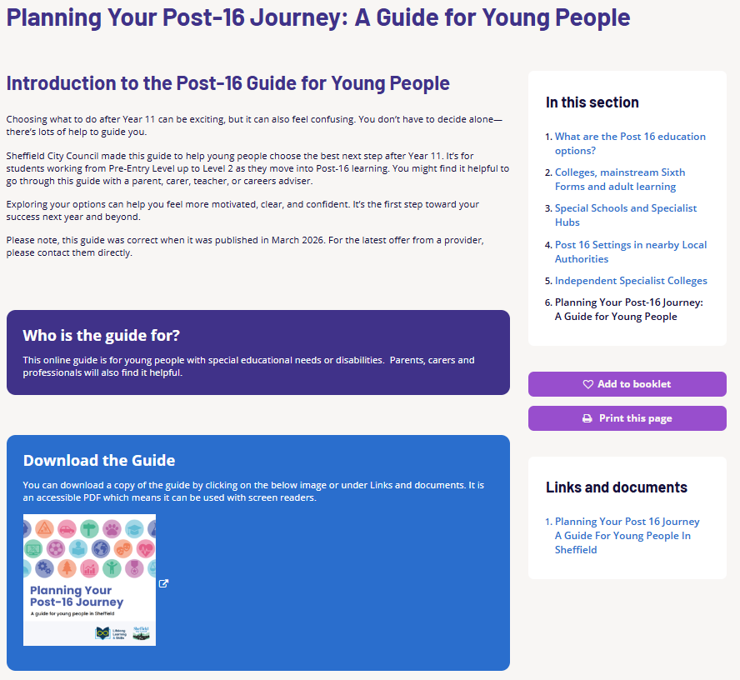
3
Sheffield City Council

Slide 4
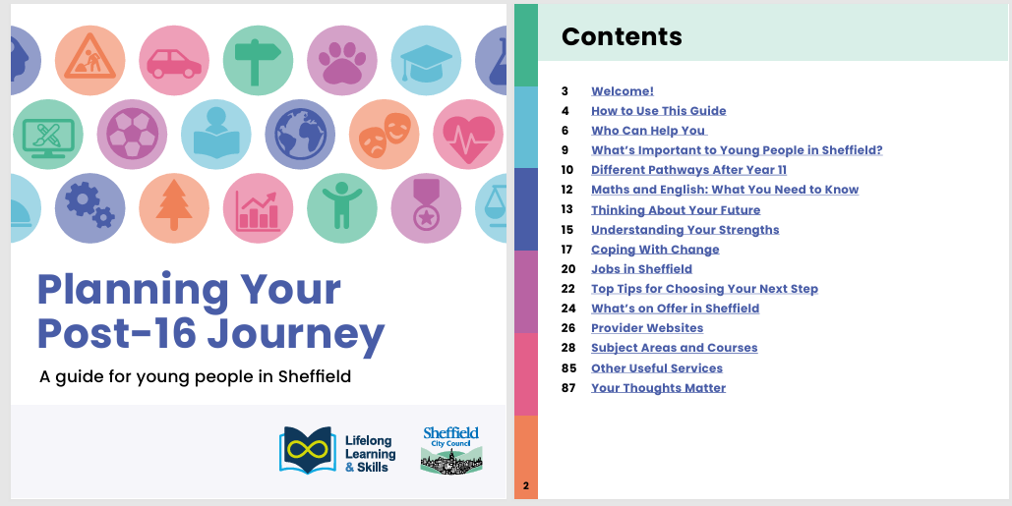
4
Sheffield City Council
Notes:
Planning your Post-16 Journey: A Guide for Young People | Sheffield

Slide 5
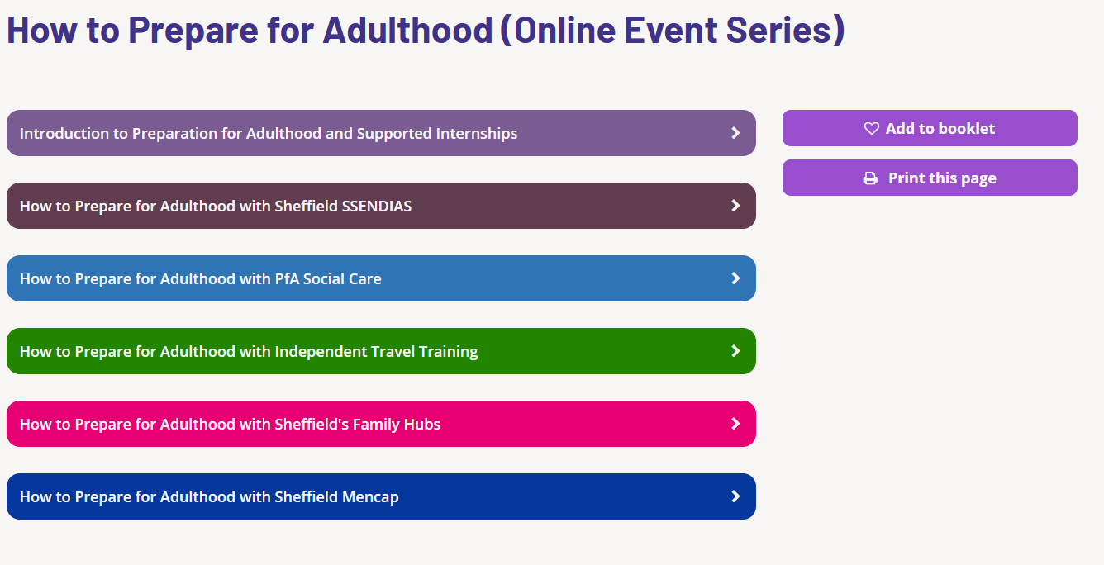
All previous event recordings and resources are online on our Local Offer website
5
Sheffield City Council
Notes:
PfA Events | Sheffield

Slide 6

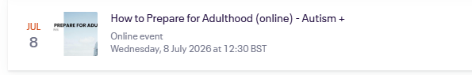
6
Sheffield City Council
Notes:
Preparation for Adulthood – Virtual Event Series | Eventbrite

Slide 7
Before you go, please share your feedback!
Thank You!
7
Sheffield City Council
Notes:
Thank you for coming today's online session with the Shared Lives Service – Fill in form

