Slide 1



How to Prepare for Adulthood
An Introduction
2nd July 2025

Slide 2
In the chat, tell us, what were the reasons you signed up for today’s session?
Welcome!
2
Sheffield City Council

Slide 3
Some Housekeeping
Today’s session will be recorded and shared with you following the event and hosted on our Local Offer website.
We’ll be monitoring the chat throughout – please share your questions or even just say hello! But please do not share any sensitive or personal information.
We will finish on or before 1:30pm.
3
Sheffield City Council

Slide 4
Today’s Session
An introduction to this series of How to Prepare for Adulthood sessions
What is meant by preparing for adulthood?
The pillars (or parts) of Preparation for Adulthood (PfA)
PfA at different ages and stages
How to get started with finding help and support
Our Local Offer website
Preparing For Adulthood Transition Guide
Planning your Post-16 Journey: A Guide for Young People
Preparing for employment – a spotlight on Supported Internships in Sheffield
Q&A
Session feedback and close
4
Sheffield City Council

Slide 5
How to Prepare for Adulthood
An Introduction to our series of online sessions
    We want all young people to achieve the adulthood that is right for them - We want to ensure that young people, their families and professionals supporting them are empowered with the information and advice needed to make this happen.
    These lunchtime sessions will include speakers from local and national organisations who can offer support along this journey to adulthood.
    It will give young people, families and professionals an opportunity to ask their burning questions.
    All sessions will be recorded and hosted on our local offer.
    We hope you get a lot from these sessions!
5
Sheffield City Council

Slide 6
What is meant by preparing for adulthood?
    Put simply, preparing for adulthood is about how we support children and young people to have the adult life that they want by building their independence as they grow up.
If a young person has special educational needs or a disability, getting ready for being an adult might need more planning and thinking ahead.
The young person is the most important person in this planning – What do they want? What do they need? What matters to them? What would they like to do when they're older?
A note about Education, Health and Care Plans (EHCPs): Talking about Preparation for Adulthood should happen at the young person's yearly review meeting as early as possible. It must be talked about from Year 9 onwards.
6
Sheffield City Council

Slide 7

Useful Resource: Planning my Future Life
Resources:
Planning my Future Life resource
Planning my Future Life - Additional Helpful Tools
More Helpful Tools for Planning
7
Sheffield City Council

Slide 8
What are the four pillars of Preparation for Adulthood?
    Work with young people across the country was carried out to define the four parts of adulthood that were most important to them. They were:
    Education, Training and Employment: Learning new things at school, college or through training, and getting ready for a job or volunteering.
    Independent Living: Learning how to do things like cooking, managing money, and working towards living in your own home.
    Friends, Relationships and Community: Having friends, meeting new people, feeling included, and being part of your local community.
    Good Health: healthy in your body and your mind, and knowing how to get help when you need it.
8
Sheffield City Council

Slide 9
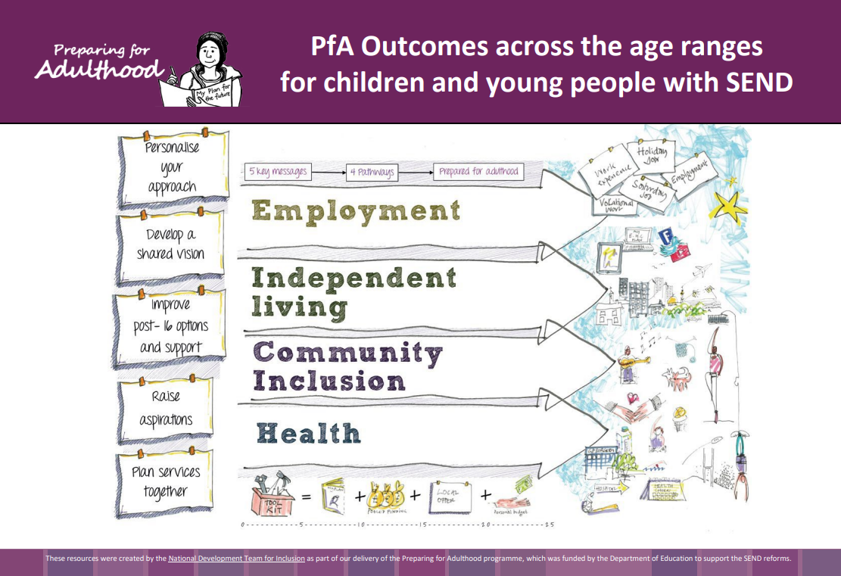
Useful Resource:
Preparing for Adulthood by Age and Stage
PfA-Outcomes-Framework.pdf
9
Sheffield City Council

Slide 10
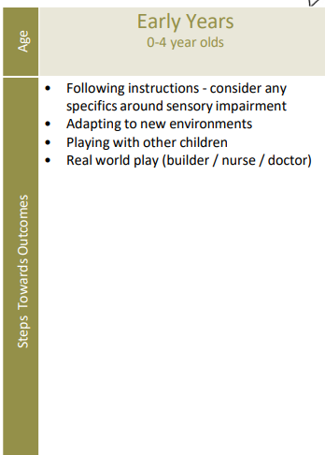
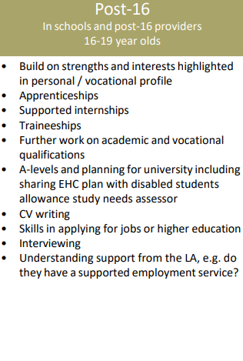
Useful Resource:
Preparing for Adulthood by Age and Stage
PfA-Outcomes-Framework.pdf
10
Sheffield City Council

Slide 11
Where To Find Help: A Starting Point
Education, Training and Employment Sheffield Futures Jobcentre Plus Supported Internships | Sheffield Employment and skills service | Sheffield City Council Planning your Post-16 Journey: A Guide for Young People | Sheffield | Independent Living Housing Guide Independent Travel Training
Friends, Relationships and Community Taking part in your community Support for LGBTQ+ young people in Sheffield | Good Health Annual Health Checks Sheffield Mental Health Guide Kooth: Free Mental Health Support for Young People
11
Sheffield City Council

Slide 12

Useful Resource:
Our Local Offer Website
Information and advice pages on the SEND Local Offer webpages to help guide you or your young person to prepare for adulthood.
Sample of what is on there:
Preparing for Adulthood - National Development Team for inclusion (NDTi) website
Preparation for Adulthood Transition guide
Post 16 Education Options
Independent travel training
Learning to Drive
Employment advice – finding a job, apprenticeships, traineeships and supported Internships, starting your own business
Sex and relationships advice
Housing advice
Money advice including benefits and how to open a bank account
Health advice including around mental health
Find it here:
https://www.sheffielddirectory.org.uk/localoffer/preparation-for-adulthood/
12
Sheffield City Council

Slide 13
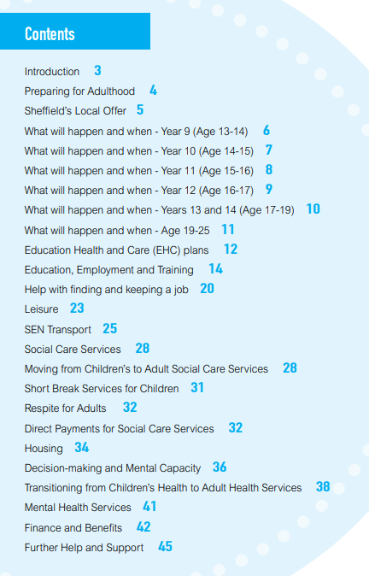
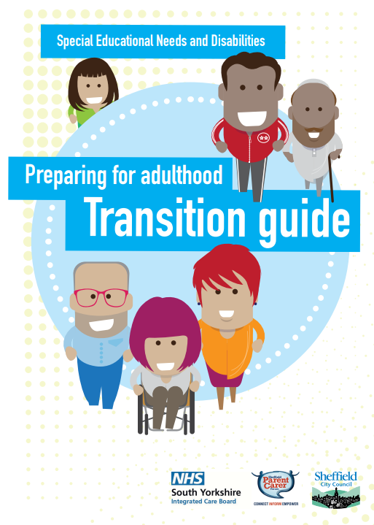
Useful Resource:
Preparing for Adulthood - Transition Guide
Find it here:
SEND Preparing for adulthood - transition guide
13
Sheffield City Council

Slide 14
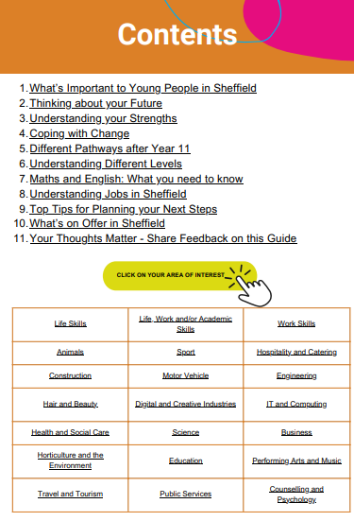

Useful Resource:
Planning my Post-16 Journey: A Guide for Young People
Find it here:
Planning your Post-16 Journey: A Guide for Young People (1) | Sheffield
14
Sheffield City Council

Slide 15
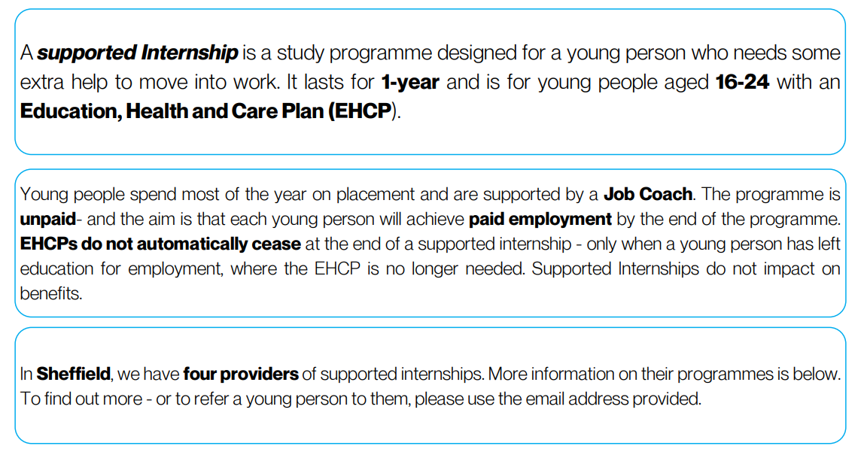
Supported Internships in Sheffield
15
Sheffield City Council

Slide 16
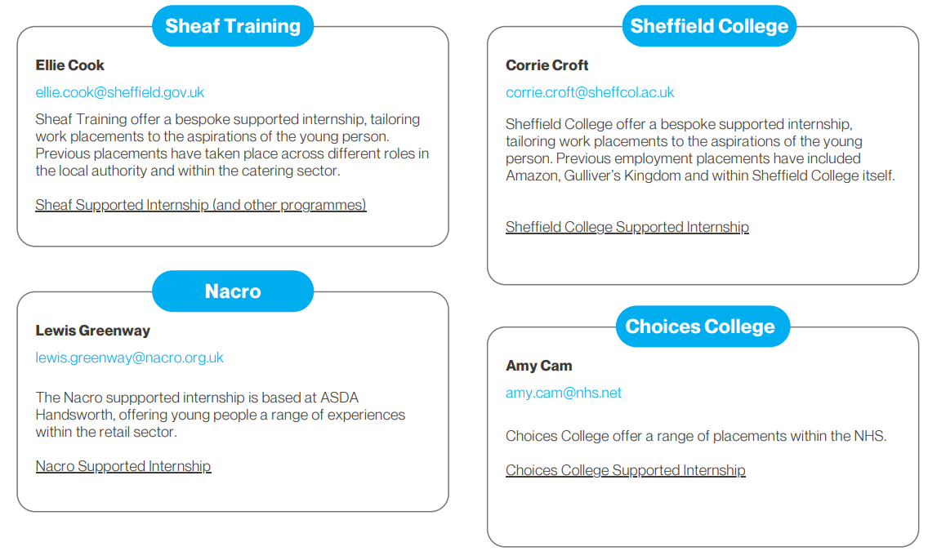
Supported Internships in Sheffield
16
Sheffield City Council

Slide 17
Your Questions
17

Slide 18
Upcoming Sessions
Session 2: How to Prepare for Adulthood (Online) – with Sheffield SENDIAS
🗓 Wednesday 9th July | ⏰12:30–1:30pm | 💻 Online via Teams
Find out how SENDIASS supports young people to be heard, make choices, and shape their futures.
👉 https://pfasendias.eventbrite.co.uk/
Session 3: How to Prepare for Adulthood (Online) – with Preparation For Adulthood Social Care
🗓 Wednesday 16th July | ⏰12:30–1:30pm | 💻 Online via Teams
Discover what support social care can offer as young people prepare for adulthood – and how to access it.
👉 https://pfasocialcare.eventbrite.co.uk/
18
Sheffield City Council

Slide 19
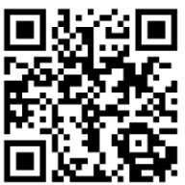
Before you go, please share your feedback!
Thank You!
19
Sheffield City Council
Notes:
https://forms.office.com/e/AtrJedCX1h

