Slide 1
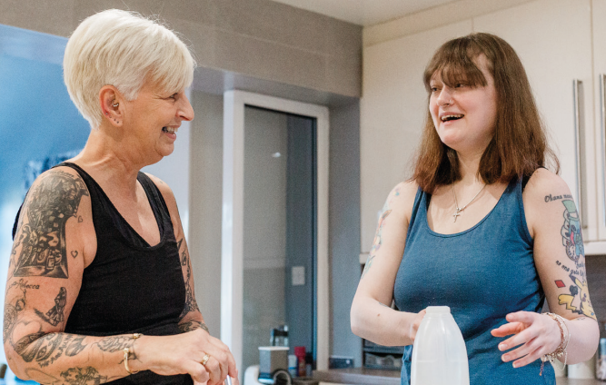
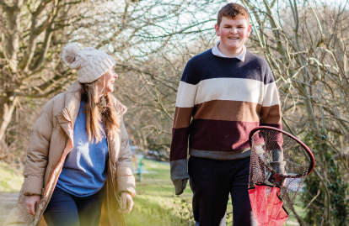
Shared Lives

Slide 2

What is Shared Lives?
Shared Lives is a regulated support service much like Fostering, but for Adults with additional needs. The scheme used to be called Adult Family Placements.
Shared Lives Sheffield is guided by the National Organisation, Shared Lives Plus and we are registered with the Care Quality Commission (CQC) and rated “Good”.
Shared Lives works with self-employed Carers and the Carers deliver all the support from their own family homes.
Carers go through a robust recruitment process and agree to complete an ongoing programme of training.

Slide 3
Who We Support
Shared Lives can support individuals who meet the eligibility criteria for Adult Social Care support. This includes those who:
have mental health support needs
have a physical impairment or disability
have a learning disability
are neurodivergent
have dementia
are older

Slide 4

What Can Shared Lives Offer?
Short Breaks (Respite)
From as little as one night per month, several nights on a regular basis, or a week or two at a time for a planned holiday. Most of our arrangements are for 42 nights per year, but we are very flexible.
Day Support
Starting with a minimum of 2 hours per week, including evenings and weekends subject to the availability of a carer match. Most of our arrangements are for 8 – 12 hours over 2 or 3 days.
Long Term Placement
A live-in arrangement where the individual moves into the carer’s home full time.

Slide 5
Shared Lives Carers
A Shared Lives Carer is someone who opens up their home and family life to include an adult with support needs.
Shared Lives Carers come from all walks of life and don’t need qualifications or experience, just the right attitude and a willingness to truly share their lives with another person.
Shared Lives Carers are carefully selected and trained by the scheme and are visited at least every 12 weeks by a member of the team.
Some Shared Lives Carers are also Foster Carers, and both types of care can happen simultaneously.
Carers are self-employed and have access to preferential tax arrangements called Qualifying Care Relief.

Slide 6
What Support Can A Carer Offer?
Shared Lives Carers can support individuals to make and attend health and medical appointments.
Carers can assist, or supervise and prompt, with personal care tasks such as showering, dressing, and administering medications.
Carers can support a person to take part in activities and hobbies of their choosing.
Carers can support a person to go on holiday or visit places of interest.
There is an expectation that an individual in a long-term arrangement also accesses other day time activities, employment, or volunteering for at least a few hours each week and Shared Lives can help to arrange this. This could even be day care with another Shared Lives family.

Slide 7
Shared Lives Carers
When an Individual is in a long-term placement the Shared Lives Carers do not manage their finances, they can however, help them to look after daily spending money.
If the Individual does not have the capacity to manage their own finances, an independent appointee will be arranged.
Carers will fill in communication sheets, financial transaction sheets, and MAR sheets for medication. They also contribute to reviews for the Individual they support.
If a Carer provides a long-term placement, they will be able to access 6 weeks paid respite leave each year. The Individual will be matched with a respite family within Shared Lives, wherever possible.
Shared Lives Carers are not expected to operate as if they are a 24-hour residential unit.
Notes:
11.05 -12

Slide 8
Shared Lives Matching
Each Shared Lives family has a unique profile created specifically about them.
Individuals that are referred to the service will have a Support Plan and Risk Assessment completed.
At our weekly Matching Meeting, new referrals will be “matched” to our family’s/carer’s that have a vacancy.
Support Plans will then be sent to the matched carer/family to ask if they would like to meet the individual and vice versa, and then Introductions will be arranged.
After an Introduction, both parties must be in agreement for the next step to go ahead.
The “Matching and Introduction Process” will be tailored to the individual’s needs and can take place over weeks or months as required.
Please remember that care takes place in a family home

Slide 9
Shared Lives Monitoring
All Carers are allocated to a named Adult Social Care Practitioner who will complete their monitoring.
(except for the Manager Visit/Observation).
2 Support Visits
1 Annual Review
1 Manager Visit
1 Review Follow Up
There is an expectation that Carers attend at least two Carer meetings per year.
All carers are self-employed and the Shared Lives Sheffield team co-ordinates the packages of care for the individual with the carer.
All carers are monitored in accordance with CQC standards

Slide 10
Shared Lives Costs
Long term without personal care per week - £522.28
+ £63 (board and lodgings paid by the individual to the carer)
Long Term with personal care per week - £596.69
+ £63 (board and lodgings paid by the individual to the carer)
Respite/Short Break per night – £97.84
+ £9 (board and lodgings paid by the individual)
Emergency Respite per night - £108.37
this includes the nightly board and lodging contribution.
Day Support - £13.27 per hour

Slide 11
Referrals
Referrals to the scheme are via a Social Worker or Social Care Practitioner.
If an Individual does not have a Social Worker or a current support package with Adult Social Care, please phone the First Contact Team on 0114 2734908 or email them at asc.howdenhouse@sheffield.gov.uk. The First Contact Team will arrange for a Care Act Assessment to be completed.
Once a referral is received by the Shared Lives Team, it will be discussed at the Matching Meeting which is held weekly on a Tuesday.
Emergency referrals will be discussed as a matter of urgency on the day they are received.

Slide 12
Shared Lives
Telephone – 0114 2735275
Email – sharedlives@sheffield.gov.uk
Service Manager – Tony Middleton
Operations Manager – Trisha Higgins
First Line Manager – Jayne Hellewell
Adult Social Care Practitioners – Kirsty Pyatt, Roxanne Kirk, Thomas Richardson
Trainee Social Worker – Madeleine Taha
Carer Support Worker – Ruth Fletcher
Business Support Manager – Sue Strong
Business Support Officers – Susan Gregory and Mohammed Rashid

Slide 13

Shared Lives Films
Shared Lives Sheffield 2025
SCIE Film Kurtis and Eddie Transitions
Shared Lives Plus Meg's Story
Shared Lives Plus Care Leaver Film
Become a Shared Lives Carer - Care Leaver Film

