Slide 1

Supported Internships at Bloom

Slide 2
Curriculum - Analysis & Review
Demographics and Distribution:
Majority of learners (58%) are female, and 69% are white.
41.8% of learners are aged 19+ (due to transitions from specialist schools or progression from college).
Increasing enrolments from Integrated Resources in mainstream schools reflect a broader trend of specialist support needs.
Economic and Social Context:
Most learners are from highly deprived areas (IMD Band 1), correlating with national disability statistics.
70% of learners in attendance at Hillsborough are from the north of the City and 78% in attendance at Peaks are from the South.
Special Educational Needs Trends:
Rising numbers of students with autism (42%) and social, emotional, and mental health (SEMH) needs (9.5%).
SEMH as a primary need has increased by 69.2% since 2021, underscoring post-pandemic mental health challenges.
152 students have EHCP’s
Progression and Achievement:
Retention is high (97.14%), but progression pathways need clarity to ensure meaningful destinations.
81.67% of learners secured progression routes in 2023/24, up from 71.56% the previous year.

Slide 3
1. Local Skills Improvement Plan:
High demand for employability skills and work-based learning to address employment gaps for learners with SEND.
Expansion of supported internships to meet local employer needs and national targets.
2. Regional Workforce Gaps:
Sheffield's disability employment rate is lower than statistical neighbours and national averages, with only 4.8% of adults with learning disabilities in paid work.
Collaboration with local authorities and employers is critical to creating viable employment pathways.
3. Local Authority Goals:
Addressing post-16 and post-18 transition gaps highlighted by Ofsted.
Supporting the accelerated progress plan for SEN provision and high-needs funding expansion.
Sheffield has a disproportionately high number of young people with SEN and EHCPs who are NEET (28.3%), highlighting the need for targeted education and employment pathways.
Local Priorities

Slide 4
National Priorities
Qualification Reforms:
Shift towards streamlined and targeted curriculum pathways (e.g., Work Skills, Independent Living, Future Choices) to reduce content overlap and ensure tailored progression.
National SEND Strategy:
Government aims to double supported internships to 4,500 annually by 2025, supported by £18 million in funding.
Focus on reducing the disability employment gap through vocational profiling, pre-apprenticeships, and employer engagement.

Slide 5
Main Challenges and Opportunities
Challenges:
National SEN staffing shortages impacting teaching quality and student experience.
Need for curriculum clarity and clearly developed pathways to avoid repetitive learning.
Opportunities:
Peaks campus development as a specialist provision for high-needs learners.
Leveraging partnerships with local authorities, employers, and community organisations to expand supported internships and social enterprises.

Slide 6
Employer & Stakeholder Engagement – Stakeholder Feedback
Local Authority and Schools
Tackle high post-16 and post-18 transition gaps locally.
Employers
Increase work-based learning opportunities, including supported internships, to address high NEET rates among SEND learners.
Students and Parents
Focus on personalised learning plans aligned with EHCP outcomes and life goals.
Create clearer progression pathways to avoid content repetition or stagnation.
Expand Peaks campus capacity for specialist provision.
Strengthen vocational profiling and employability skills to meet workforce demands.
Prioritise mental health, social, emotional, and communication support to address growing SEMH needs.
Need clarity around curriculum offer
Notes:
When:
Ongoing throughout the academic year, with key meetings in multiple rounds involving internal and external stakeholders.
How:
Regular feedback sessions with students, parents, and staff.
Collaboration with local employers, Sheffield Local Authority (LA), and special schools.
Data analysis: Local Skills Improvement Plan (LSIP), Labour Market Information (LMI), and self-assessment reports.
Insights from national reports (e.g., Think Work First, Ofsted).
With Whom:
Internal Stakeholders: Curriculum leads, teaching staff, inclusion teams.
External Stakeholders: Employers, Parent Carer Forum, PfA board reps.
Key Partners: Local special schools (Bents Green, Talbot, Seven Hills), Sheffield LA, supported internship employers.

Slide 7
Employer & Stakeholder Engagement – Steps Taken in Response
1. Curriculum Design:
Streamlined three-year pathways: Work Skills, Independent Living, Future Choices.
Introduced bespoke timetables tailored to individual learning needs.
2. Capacity Expansion:
Developed Peaks campus as a specialist hub, with plans for 200 additional high-needs places.
3. Partnership Development:
Strengthened employer relationships to expand supported internships and job placements.
Collaborated with Sheffield LA to address transport and transition challenges.
4. Student Support Enhancements:
Increased mental health resources with staff training and new support roles.
Added assistive technology assessments at entry to improve accessibility.
5. Employer Engagement:
Consulted employers to design work-based learning opportunities aligned with local and national priorities.

Slide 8
Progression is the key
The Curriculum
-Work Skills (Entry level)
-Supported Internship (Entry Level)
-Supported Pathway to Work (Entry Level)
-Introduction to Work (Level 1)
Work Skills Pathway
Year 1: Foundational employability skills and workplace readiness.
Year 2: Intermediate skills tailored to specific job roles.
Year 3: Supported internship with real-world work experience.
Progression Routes
Supported Internships: For employment-focused learners.
Study Programmes: For further education transitions.
Apprenticeships: For work-based learning readiness.
Employment: For work ready learners
Links with adult social care provision
Independent Living Skills
Independent Living Pathway
Year 1: Basic life skills (e.g., cooking, budgeting).
Year 2: Intermediate skills tailored to personal goals.
Year 3: Advanced skills for independent or supported living.
Personal Progress (Entry level)
Future Choices Pathway
Year 1: Explore interests and build foundational skills.
Year 2: Develop specialist skills or hobbies with an employment focus.
Year 3: Apply skills in practical projects or community-based activities.
Notes:
Starting from the end when re-designing the curriculum

Slide 9
The new curriculum
Workskills pathway
Independent Living Pathway
3-Year Development:
Future Choices (replacing Personal Progress)
New Provision:
Replaces the three repetitive "Work Skills" streams with progressive, tailored skill-building.
Progression Opportunities:
Paid employment, further training, or supported apprenticeships.
Student Choices:
Supported internships, pre-apprenticeships, or paid employment.
Year 1: Basic life skills (e.g., cooking, budgeting).
Year 2: Intermediate skills tailored to personal goals.
Year 3: Advanced skills for independent or supported living.
New Provision:
Streamlines and replaces entry-level independent living courses.
Progression Opportunities:
Transition to independent living or further life skills training.
Student Choices:
Modules aligned with EHCP outcomes and personal goals
New Provision:
Rebrands “Personal Progress” with clearer outcome focus.
Progression Opportunities:
Transition to Independent Living, entry-level work skills, or social care programs.
Student Choices:
Flexible pathway switching based on interests and progress.
Notes:
Reduce recycling of students
Give clear pathway (ie removing work skills x 3 etc)

Slide 10
The new curriculum
All courses run over 3 years (unless required to extend due to individual needs)
Bespoke timetables operating on a matrix system
Emphasis on vocational profiling to improve access to work and further qualifications.
Progressive pathways aligned with reforms.
Incorporates SIQAF standards for employment-focused pathways.
Year 1:
Learning
Year 2: Knowing
Year 3: Doing

Slide 11
CIAP Section C: Improving Student Experience
Attendance
Transition coordinators in interviews.
Strong Initial Assessment.
Maintain close contact with students and families.
Strengthen SM roles
Blended Learning
Digital platforms for soft outcomes (e.g., Padlet).
Adaptive tech for blended learning.
Virtual central space for streamlined sharing.
TSC Guarantee Activity
Forge employer relationships for work activity.
Increase Supported Internship participation.
Inclusivity
Mental health first aiders and SEMH CPD.
Cross –programme engagement (matrix timetables) engagement for flexibility.
RARPA at the core of all that is done
Assessment Practices
Baseline assessments for clear starting points.
Staff training in RARPA processes.
Pathways aligned with PfA outcomes.
Bespoke Timetables
Tailored timetables aligned with EHCP outcomes.
Assistive technology assessments at entry.
Inclusive spaces: sensory rooms, living suites, adaptive labs
Notes:
Accessibility
• Implement bespoke timetables based on student needs, ensuring alignment with EHCP outcomes and personal goals.
• Introduce assistive technology assessments at the point of entry to equip students with the tools they need to access learning effectively.
• Develop sensory spaces, independent living suites, and adaptive technology labs to create inclusive and engaging environments.
Attendance
• Strengthen transitions by involving Transition and Progression Coordinators in interviews to ensure appropriate placement and reduce anxiety.
• Enhance transport solutions by working with the Local Authority on direct transport grants to families, ensuring smoother commutes for students.
Inclusivity
• Embed mental health initiatives, including recruiting mental health first aiders and providing CPD for staff in SEMH support.
• Develop pathways that allow cross-programme engagement (e.g., a student in Work Skills can also access Independent Living modules).
Assessment Practices and Outcomes
• Introduce comprehensive baseline and initial assessments to establish clear starting points for each learner.
• Train staff in RARPA (Recognising and Recording Progress and Achievement) processes to ensure effective assessment and evidence collection.
• Align all pathways with Preparing for Adulthood (PfA) outcomes to ensure meaningful and measurable results.
Blended Learning and Digital Technologies
• Leverage digital platforms like Padlet to capture soft outcomes and evidence progress towards EHCP goals.
• Expand blended learning opportunities using adaptive technologies to support individual learning styles.
• Develop a virtual central recording space for the Inclusion and Curriculum Teams to ensure streamlined information sharing.
Participation in TSC Guarantee Activity
• Expand work-related activity opportunities by forging relationships with inclusive employers and introducing vocational profiling.
• Increase participation in Supported Internships, with a focus on employment-based outcomes for all learners.

Slide 12


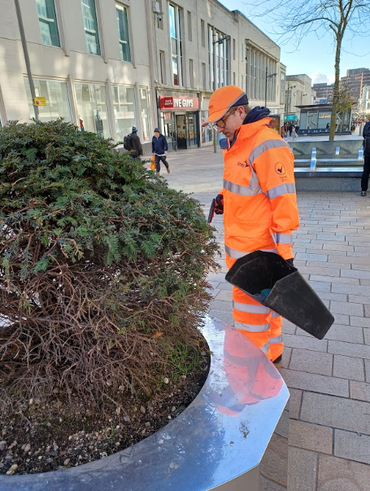
What is a Supported Internship?
Sustainable paid employment
One year
Transition to work from college
Learn on the job with a job coach
Job carving
Full time (usually)
Eligibility
Need EHCP
16-24

Slide 13

Why are they important?
Less than 6% of adults with a learning disability or difficulty in England are in paid work
More than 60% are willing and able to work
76% of people aged 16 to 64 in the general population in England who are in paid work
ONS and NHS data -2023

Slide 14

What is a SI?
Work with employer
Job coach support
rotations
Job carving
Help with interviews, applications etc.
Help with A2W
PAID meaningful work – a real job
16-19 study programme funding

Slide 15

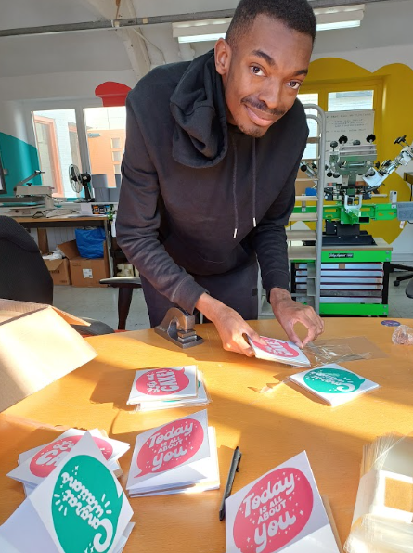
Access to Work
Trialling this year at Gulliver's
Covers:
Travel costs to/from the work opportunity
The cost of job coach support whilst at the work
opportunity
Any equipment needed to access the job/workplace
Follows the student into work

Slide 16
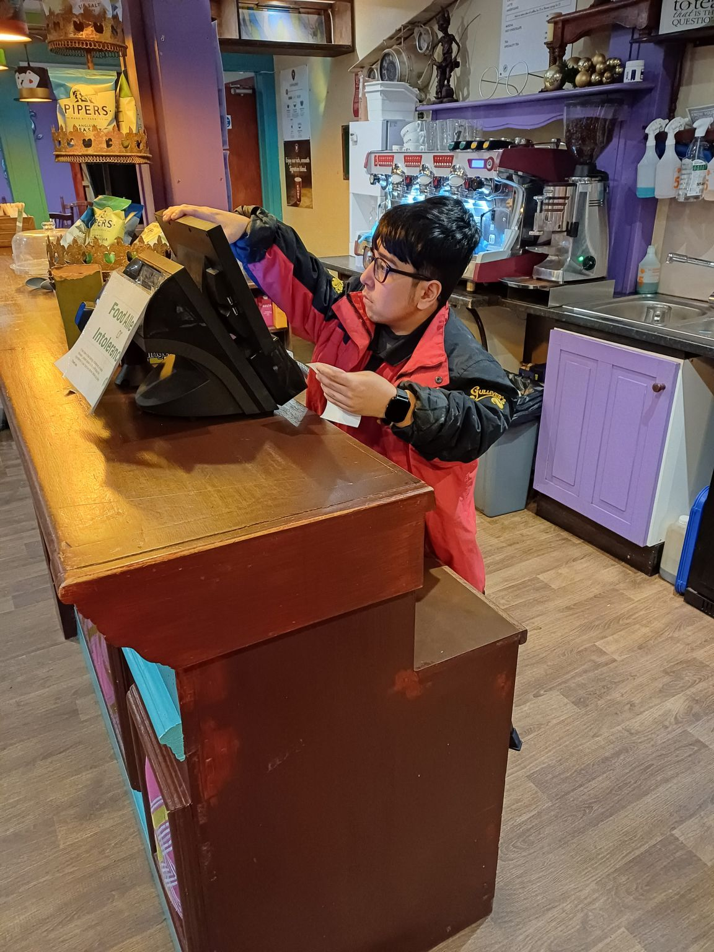
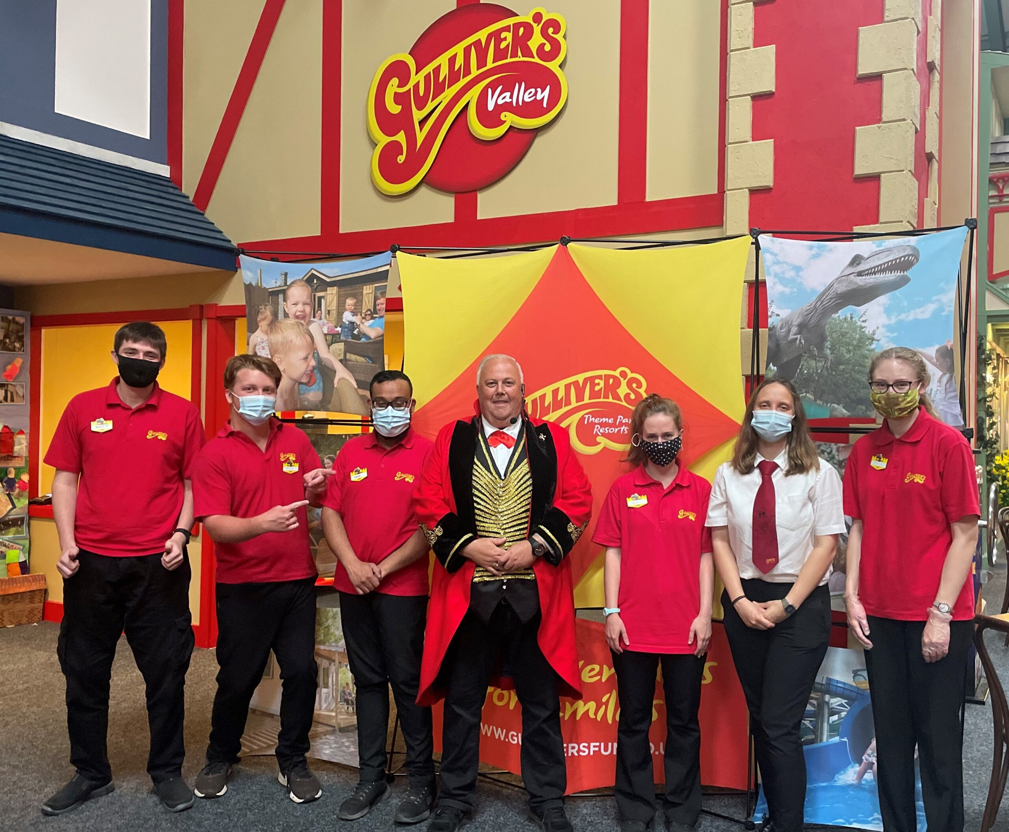

At Sheffield College – 25/26
Gulliver’s (Peaks) – 12 placements
Peaks Bespoke pathway – 1 group of 10
Bespoke at Hills – 2 groups of 10 (Bespoke pathway – 3 days)

Slide 17
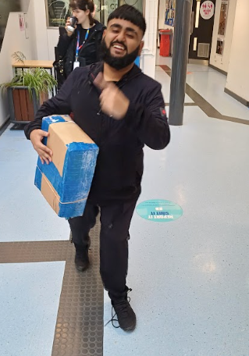

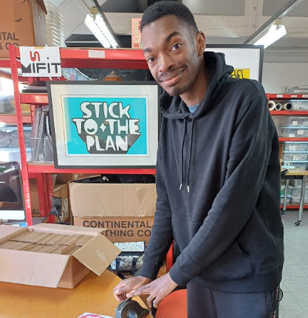
Resources
NDTI SI info for families https://www.ndti.org.uk/resources/internships-work-all-resources/internships-work-resources-for-young-people-families
Easy read info for young people: https://www.ndti.org.uk/assets/docs/What-are-Supported-Internships-Easy-Read.pdf
DfE guidance: https://www.gov.uk/government/publications/supported-internships-for-young-people-with-learning-difficulties/supported-internships
Guide for employers: https://www.ndti.org.uk/assets/files/Supported-Internships_Employer-Guide-accessible-PDF.pdf
Nasen Info link: https://asset.nasen.org.uk/7c-%20Supported%20Internships.pdf
BASE https://www.base-uk.org/supported-internships-and-inclusive-apprenticeships

