Slide 1
Sheffield Mencap and Gateway

Slide 2
About us
Sheffield Mencap and Gateway was formed in 1951 by the parents of children with learning disabilities.
Whilst we share our name with the national Mencap charity, we are a separate and entirely independent organisation, dedicated to supporting the local learning disability community in Sheffield.
“Our vision is that all people with a learning disability and their carers in Sheffield are valued, included and respected so they can live fair, full and happy lives.”

Slide 3
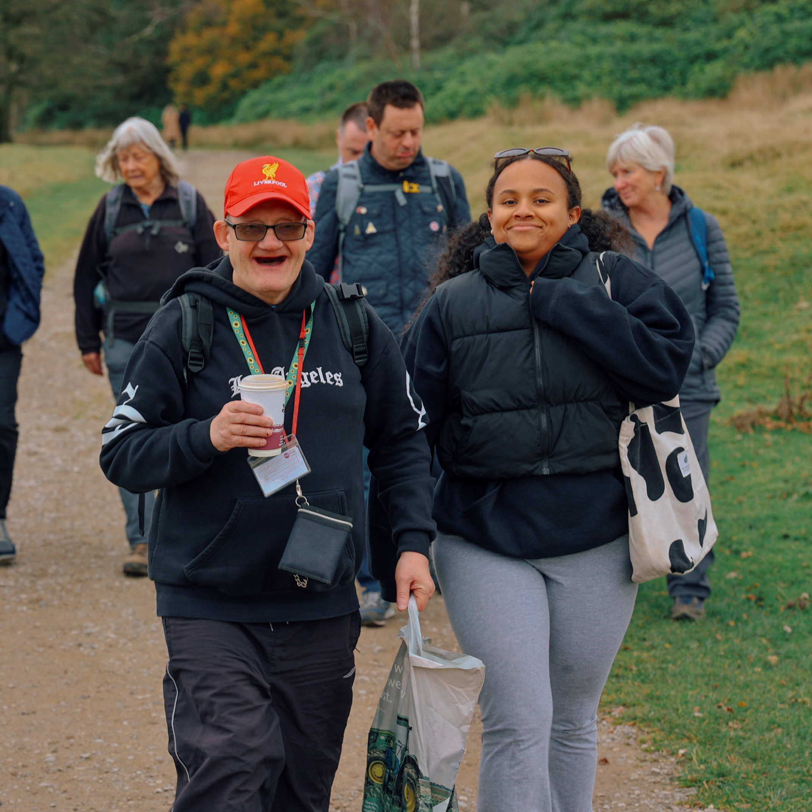
Our work
We pride ourselves on providing the lifelong support needed by the learning disability community and building long-term relationships with families.
We have over 700 members from across Sheffield currently accessing our services, from inclusive baby groups through to 1-2-1 support for elderly carers.

Slide 4
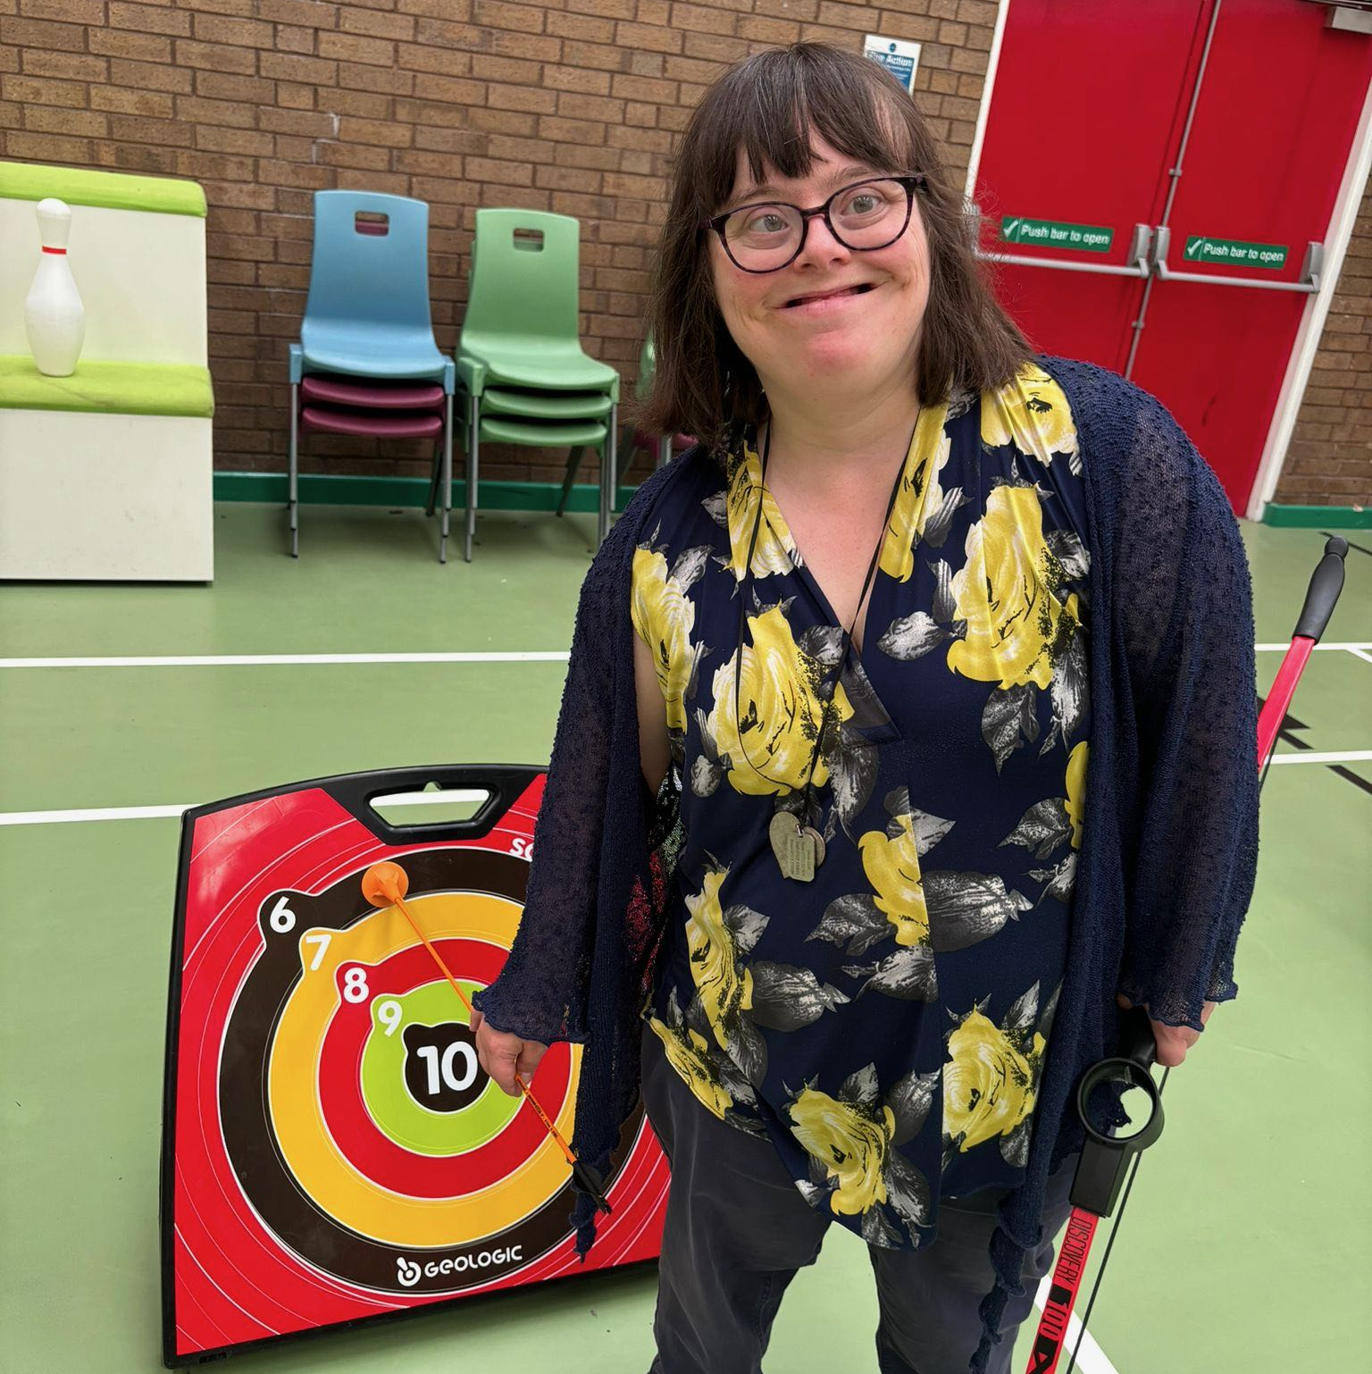
Our values
Community
We support people to become active members of their community.
Relationships
We facilitate social connection and positive relationships.
Independence
We provide choice and opportunities to build skills for life.
Confidence
We encourage people to believe in themselves and recognise their potential.
Wellbeing
We promote better physical, mental and emotional health.

Slide 5
Our services
Children
Adults
Saturday Stars
Gateway youth club
Fitness
‘Activity Learning Hub’ day service
‘Mencap Go’ groups in the community
‘Gateway’ evening social club
‘My Mencap’, member voice group
Sports and social groups: football, cricket, snooker, fitness
Carers
’Caring for Carers’ social, wellbeing and support groups
1-2-1 carer support worker
Lunch club
Health
Visiting
Service
Annual Health Checks
Workshops
My Health

Slide 6
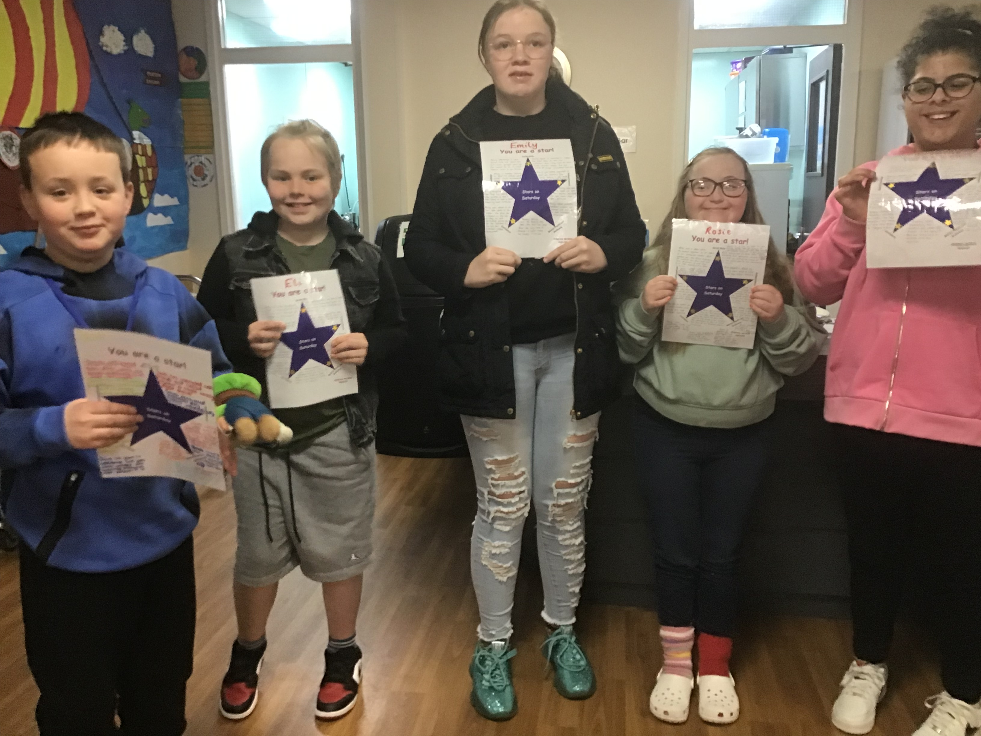
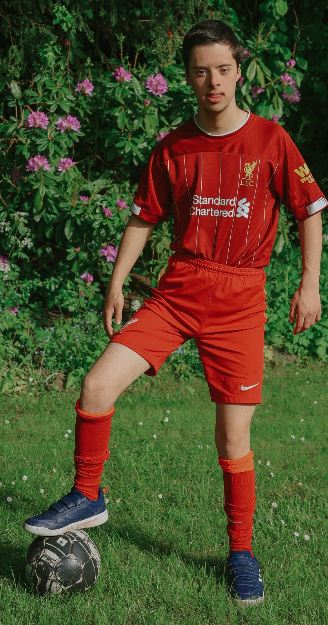
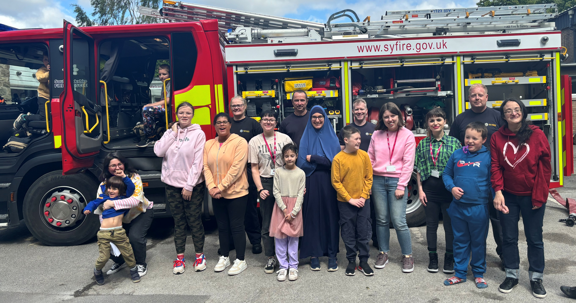
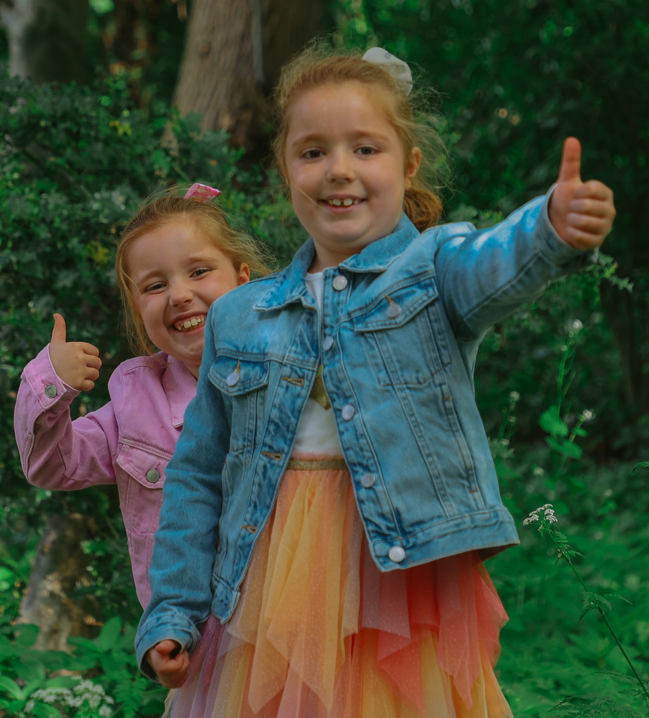
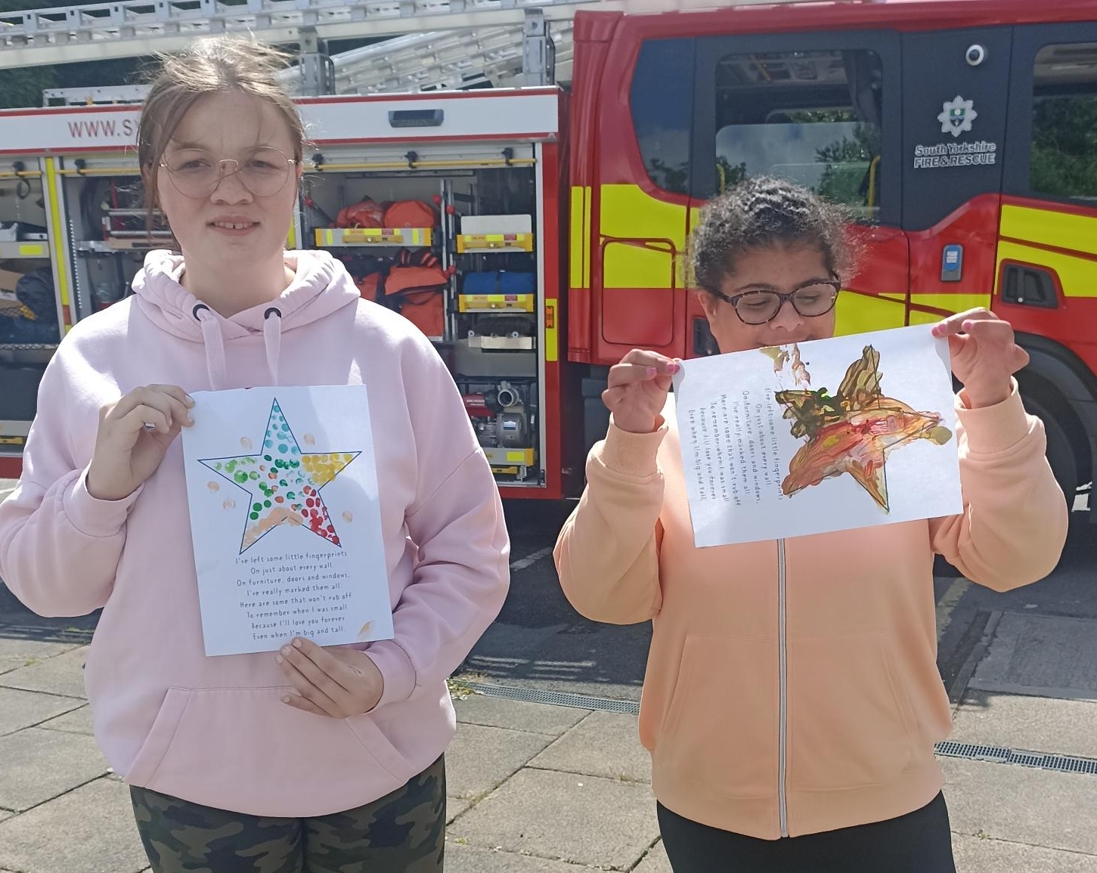
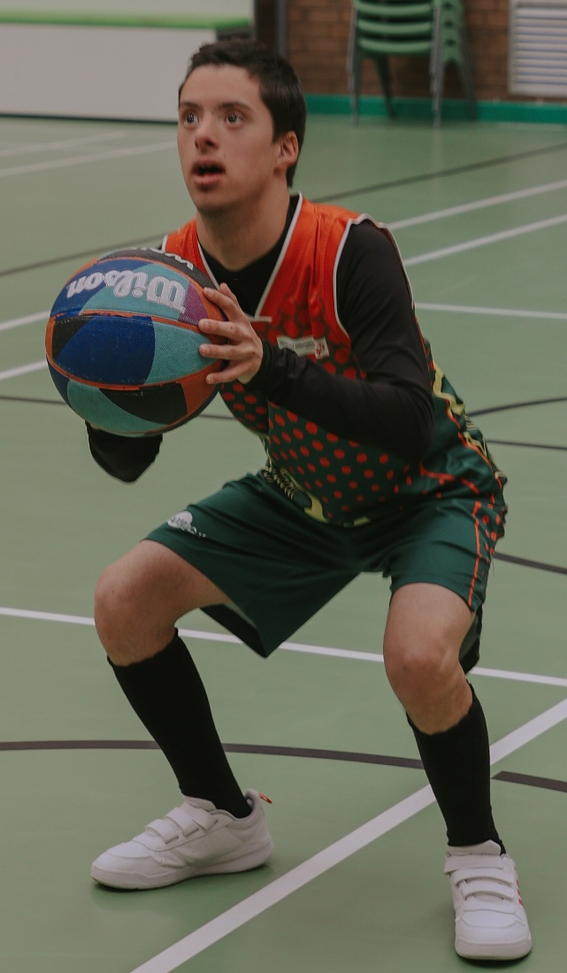
Childrens
Services

Slide 7
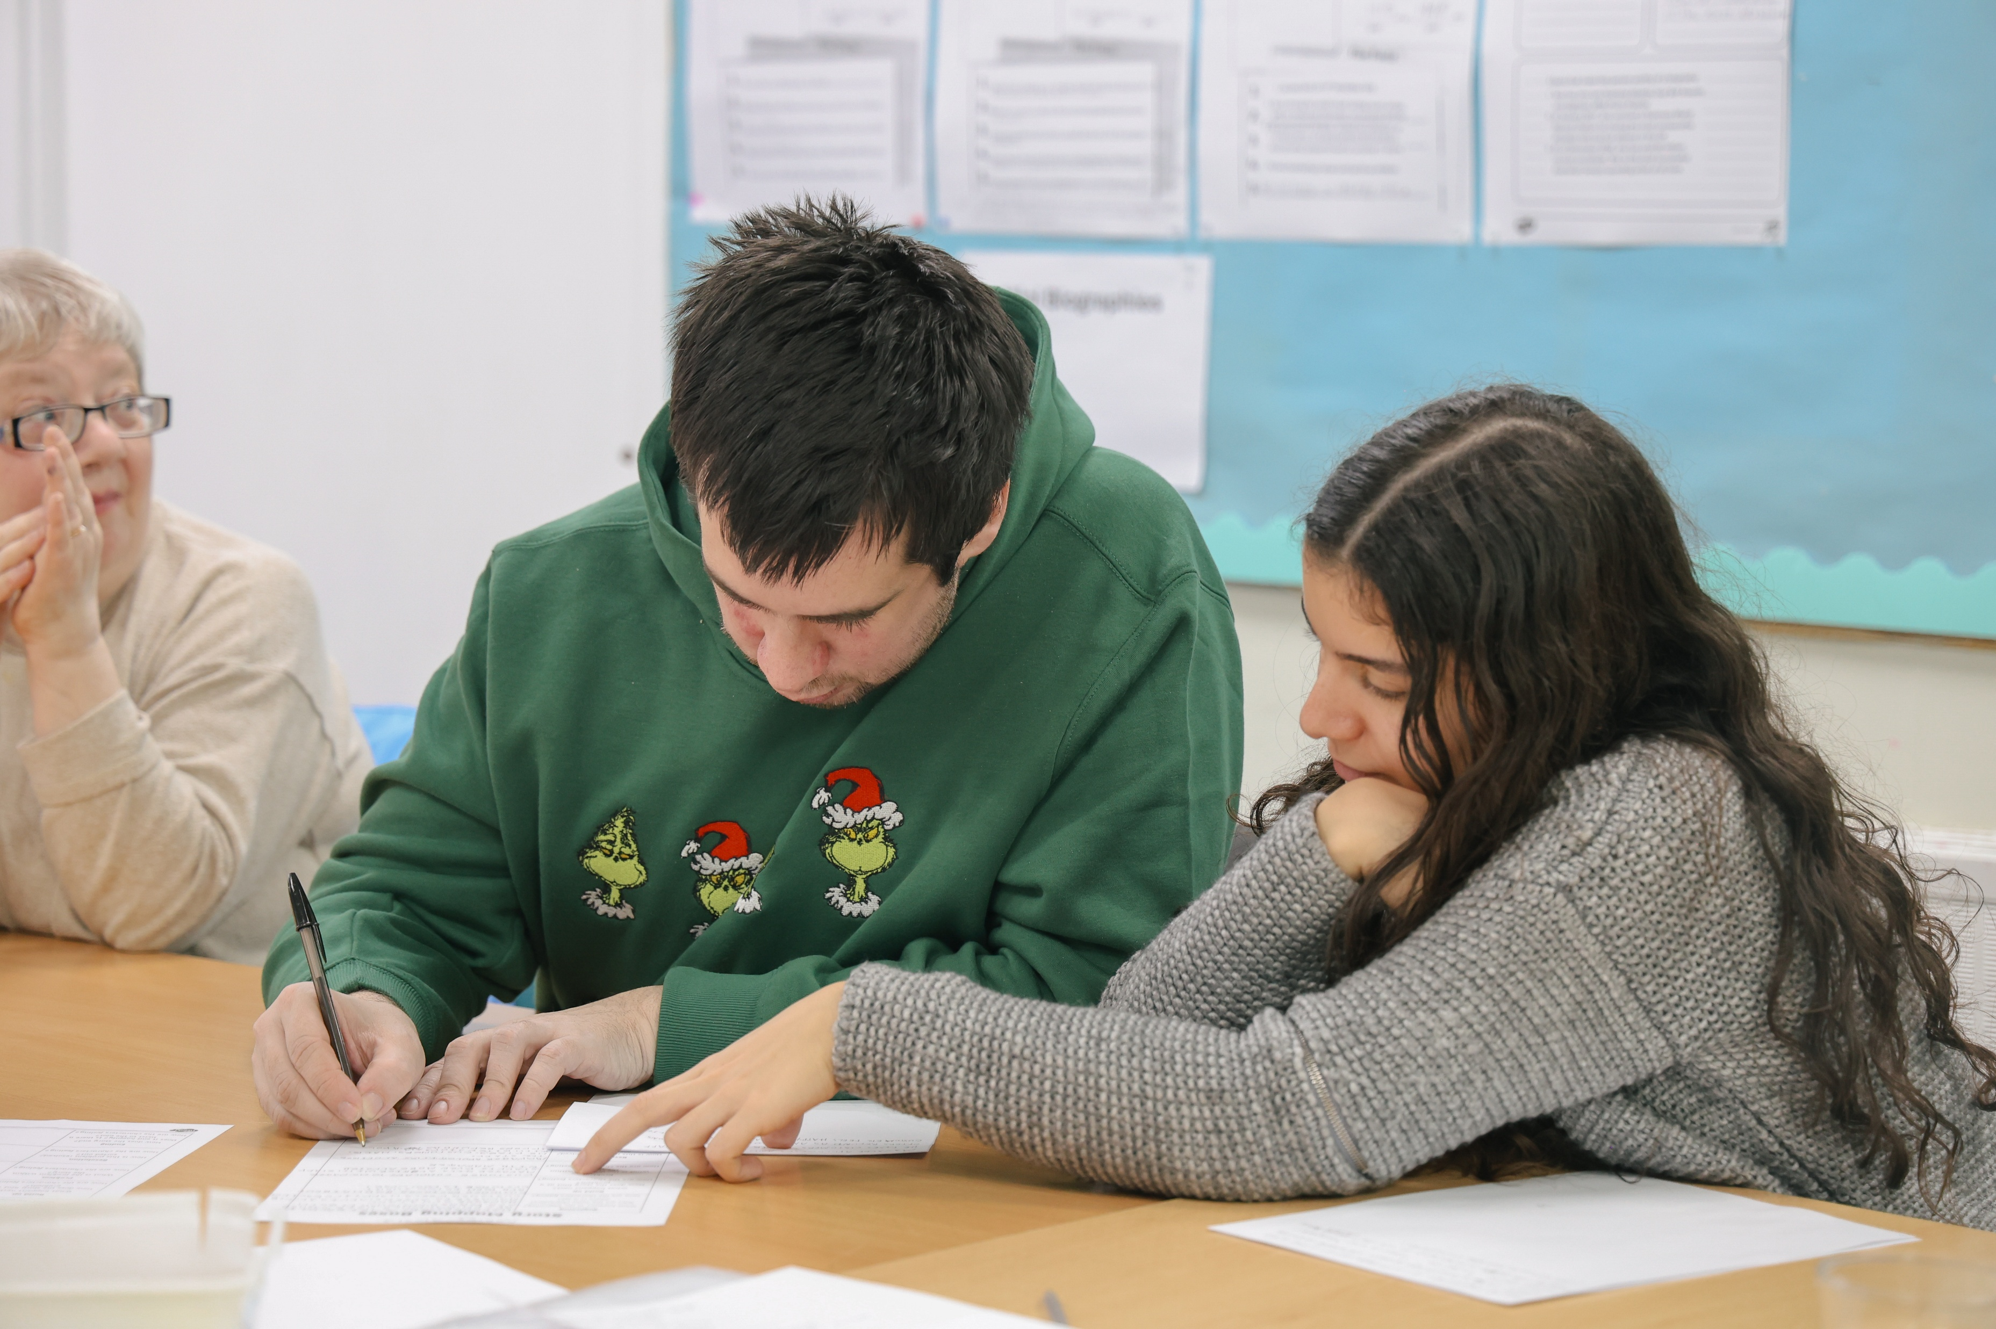
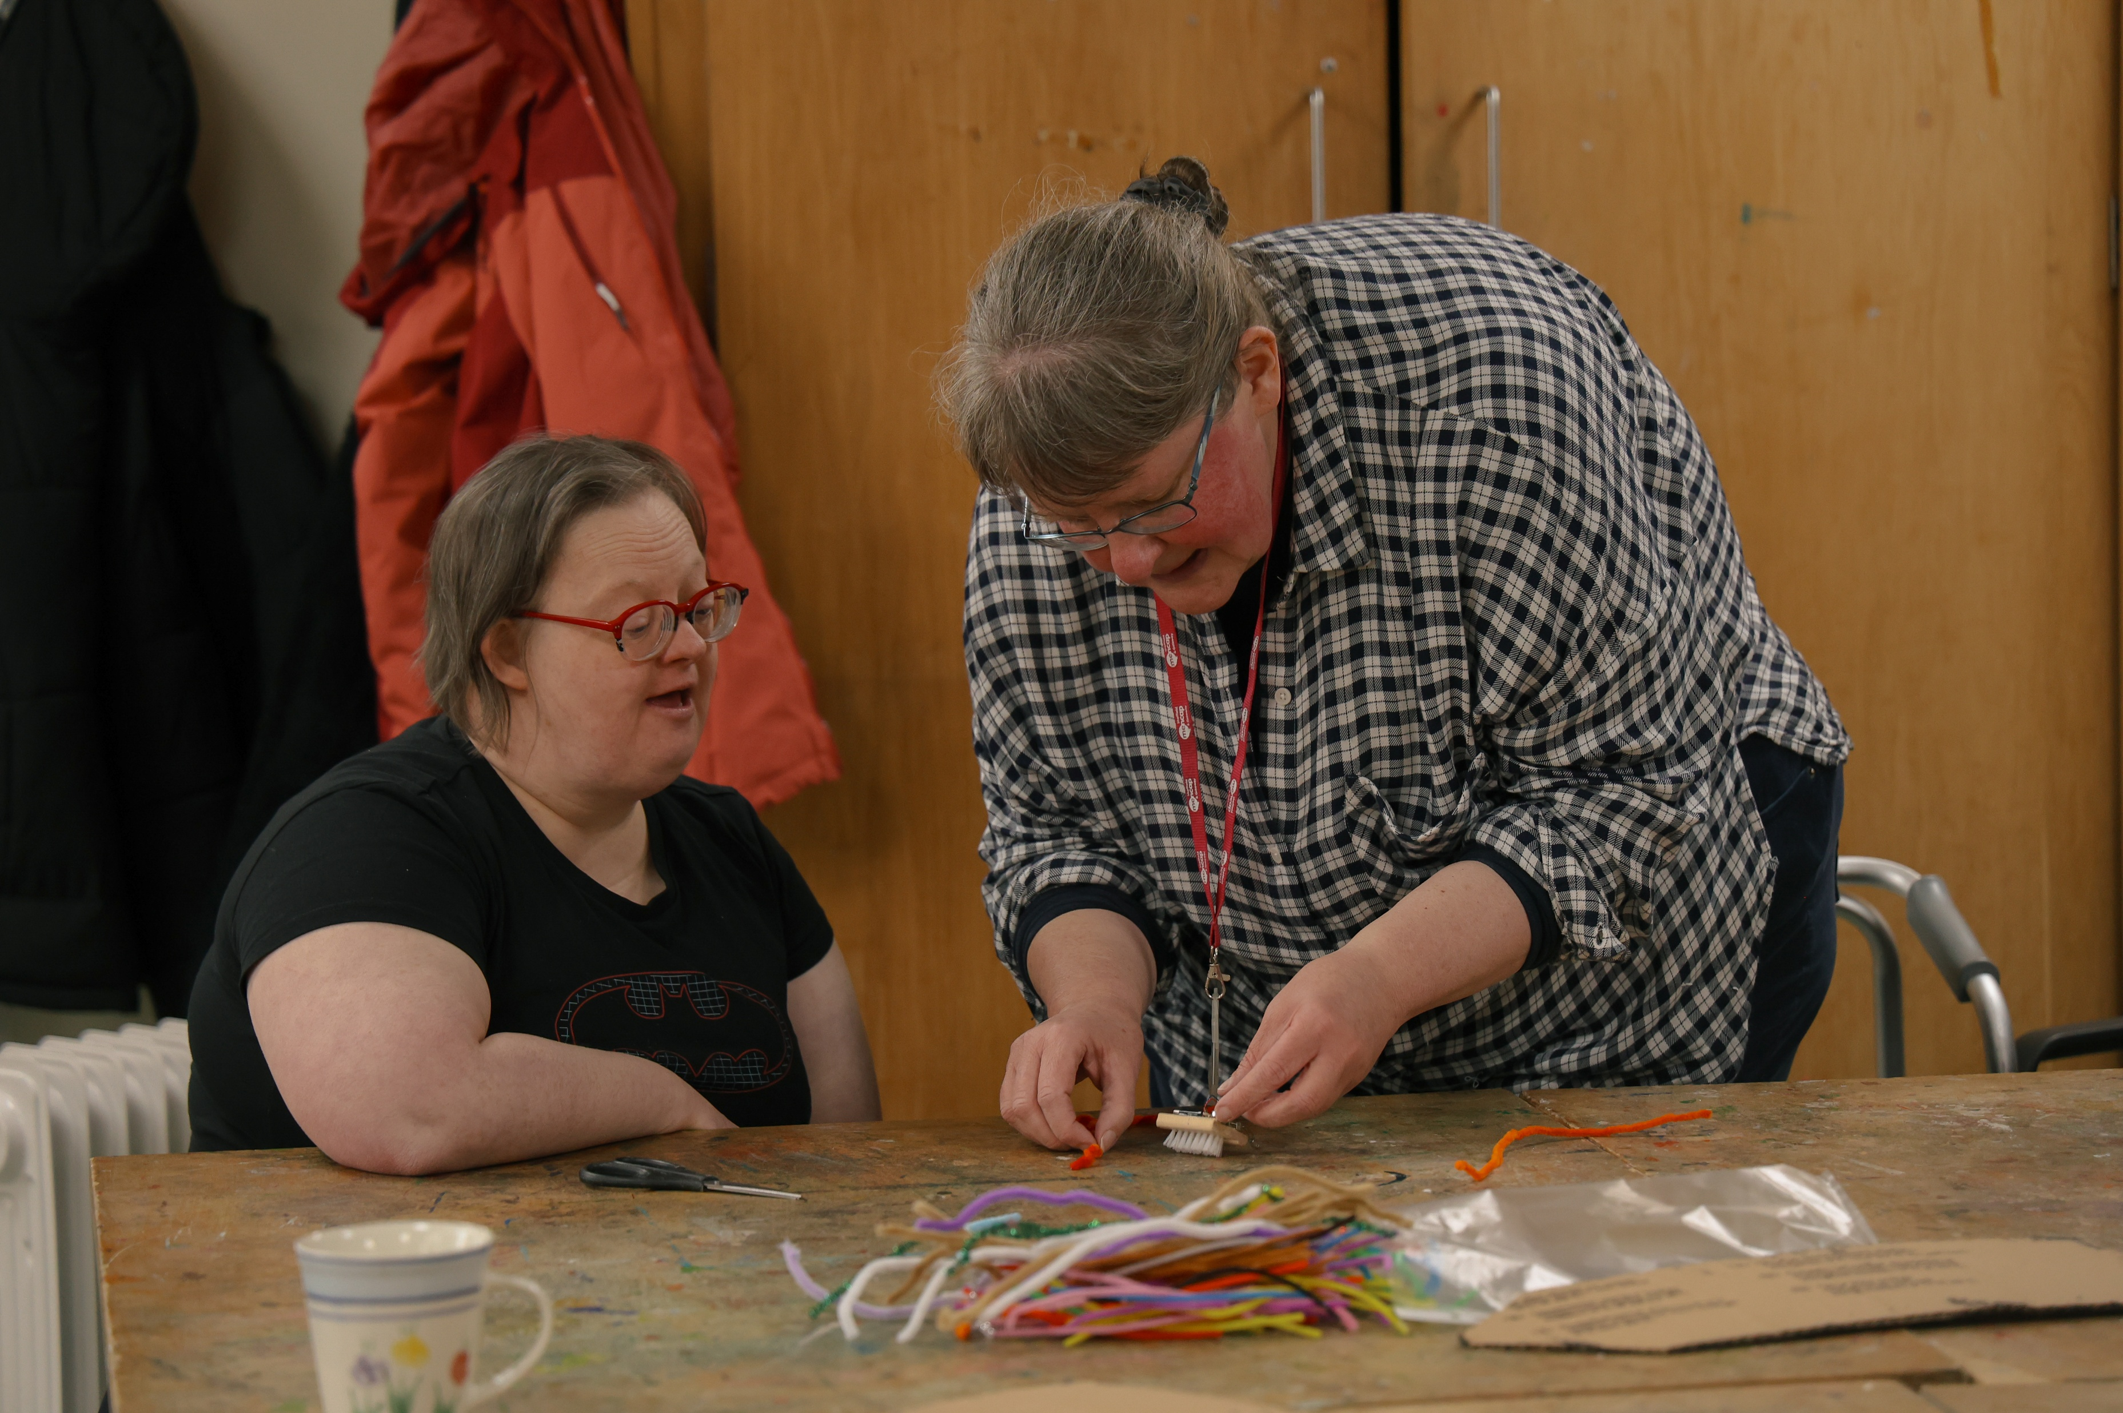
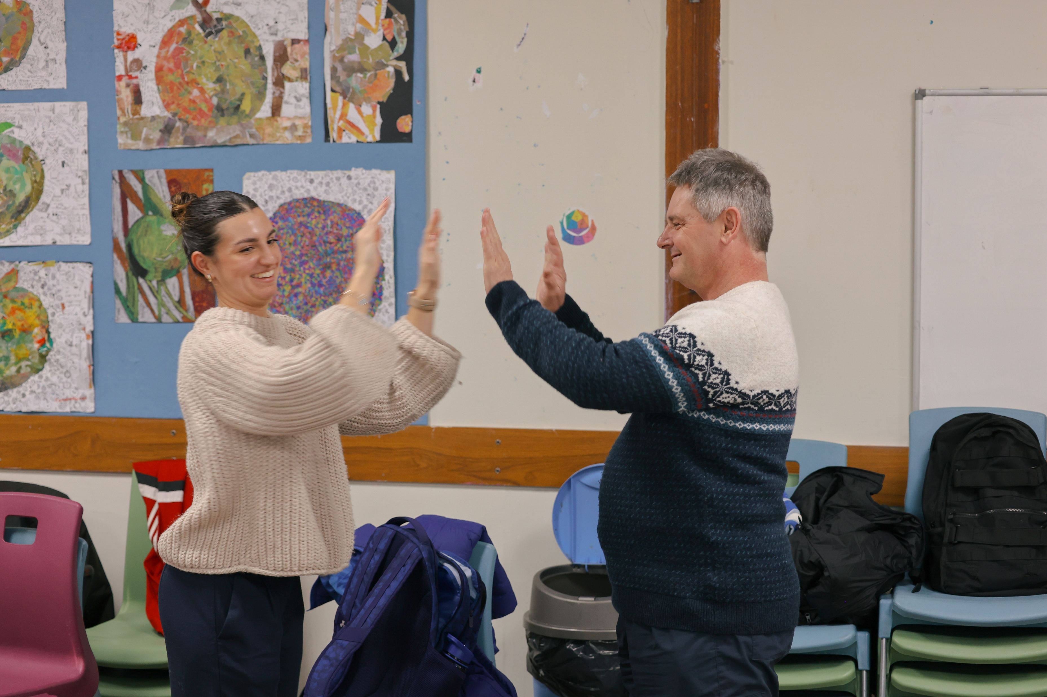
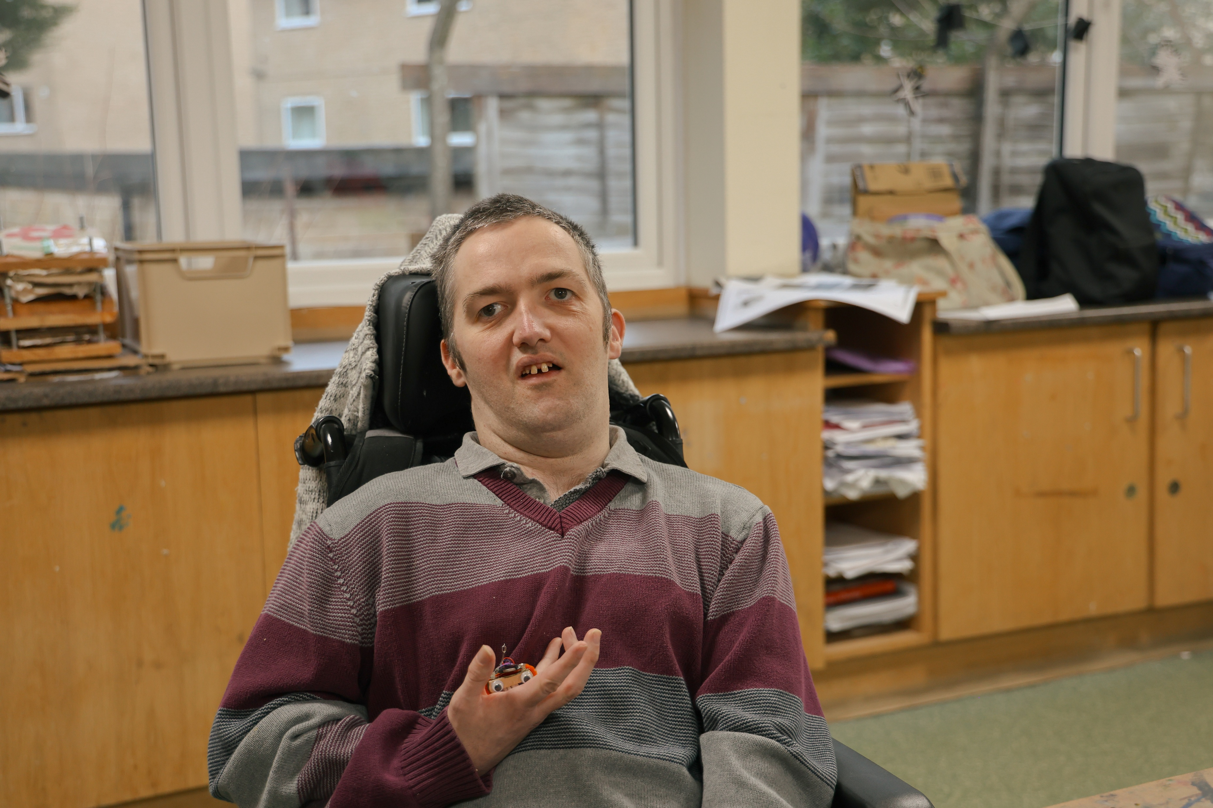
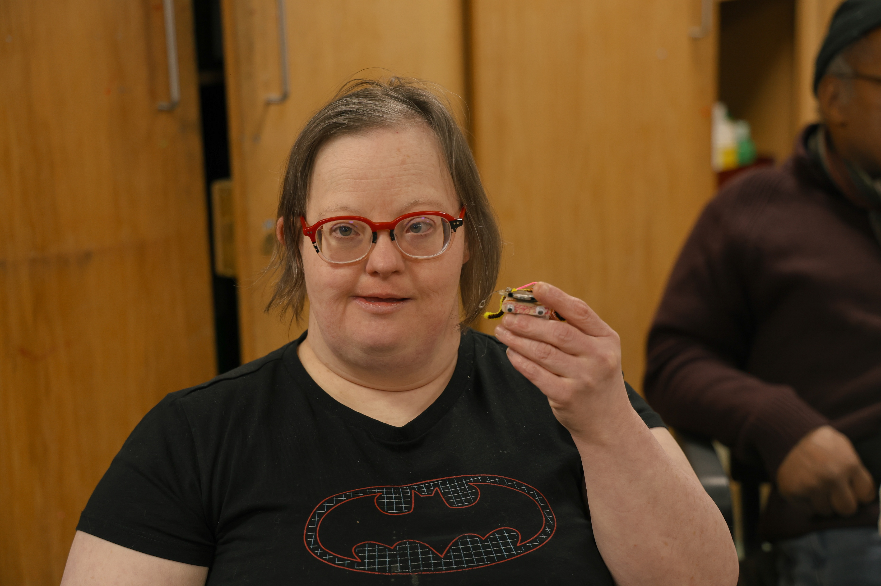
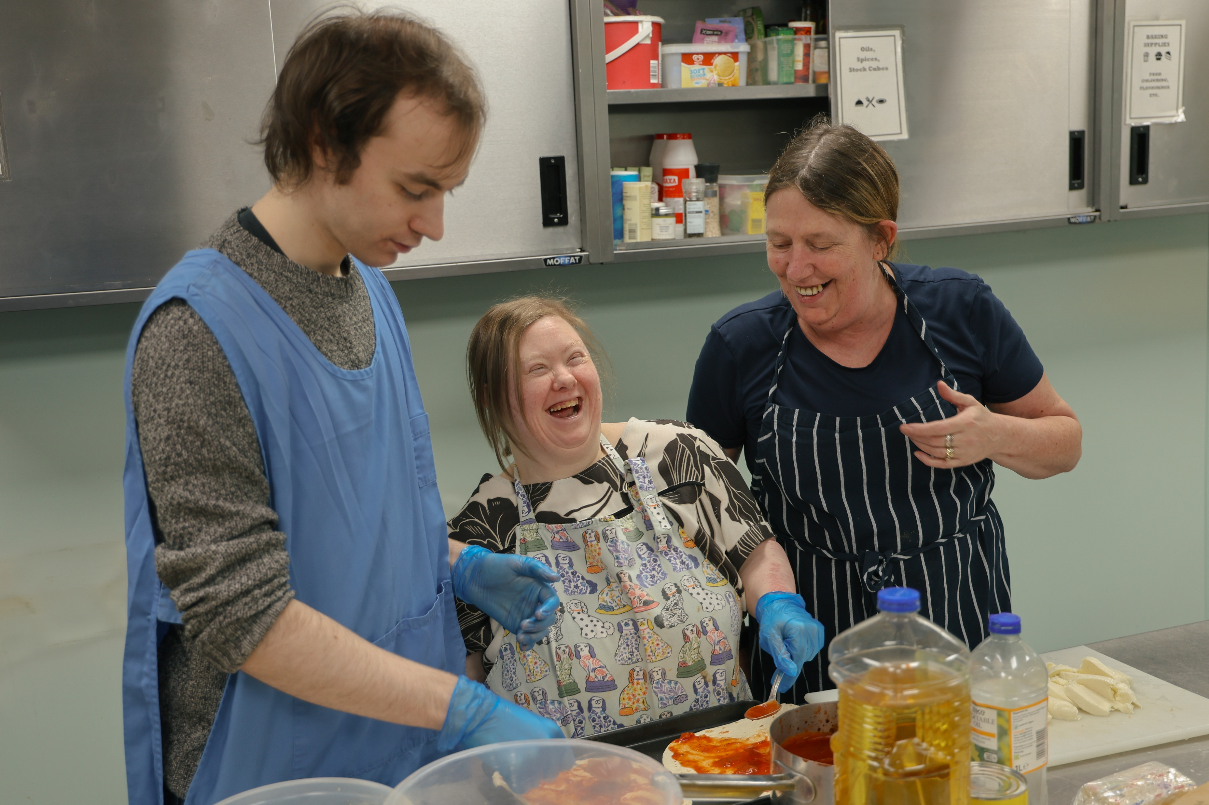
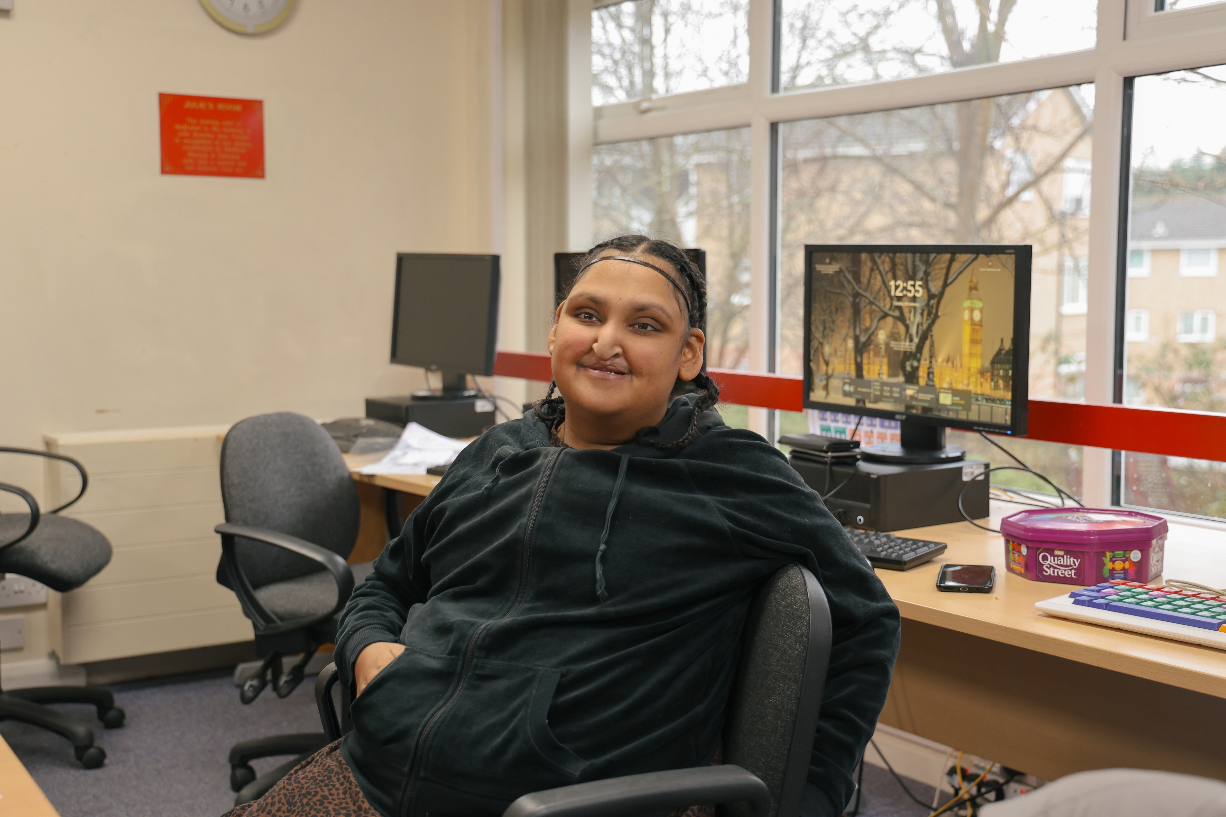
Activity
Learning
Hub

Slide 8
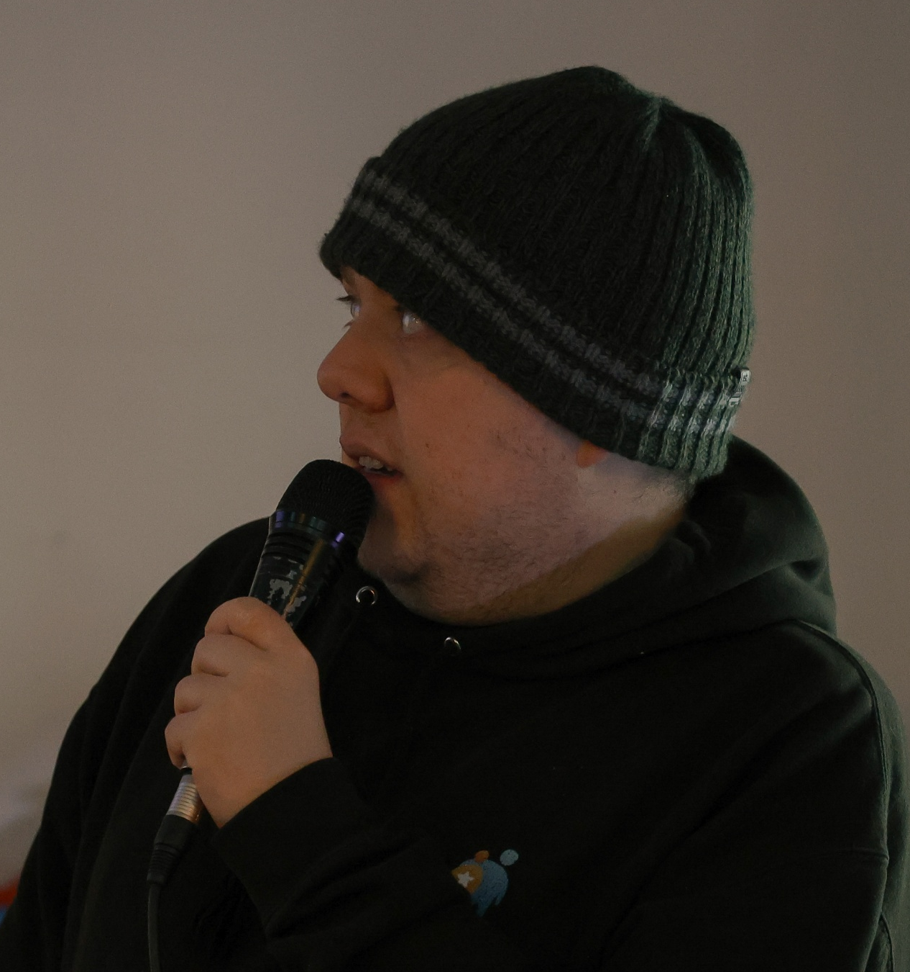
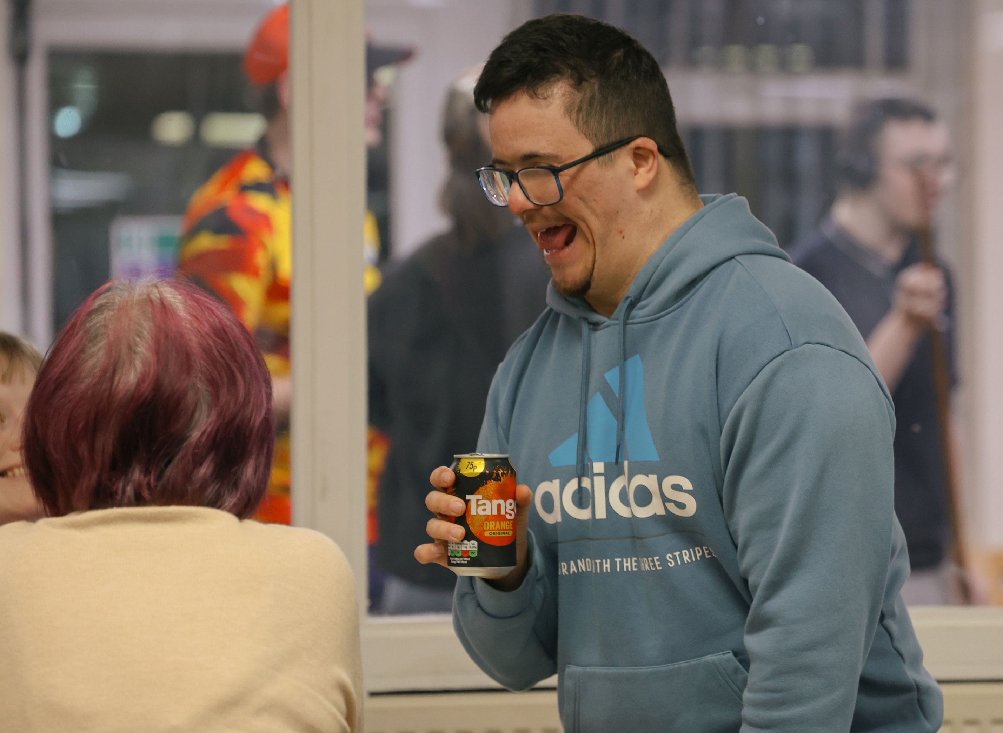
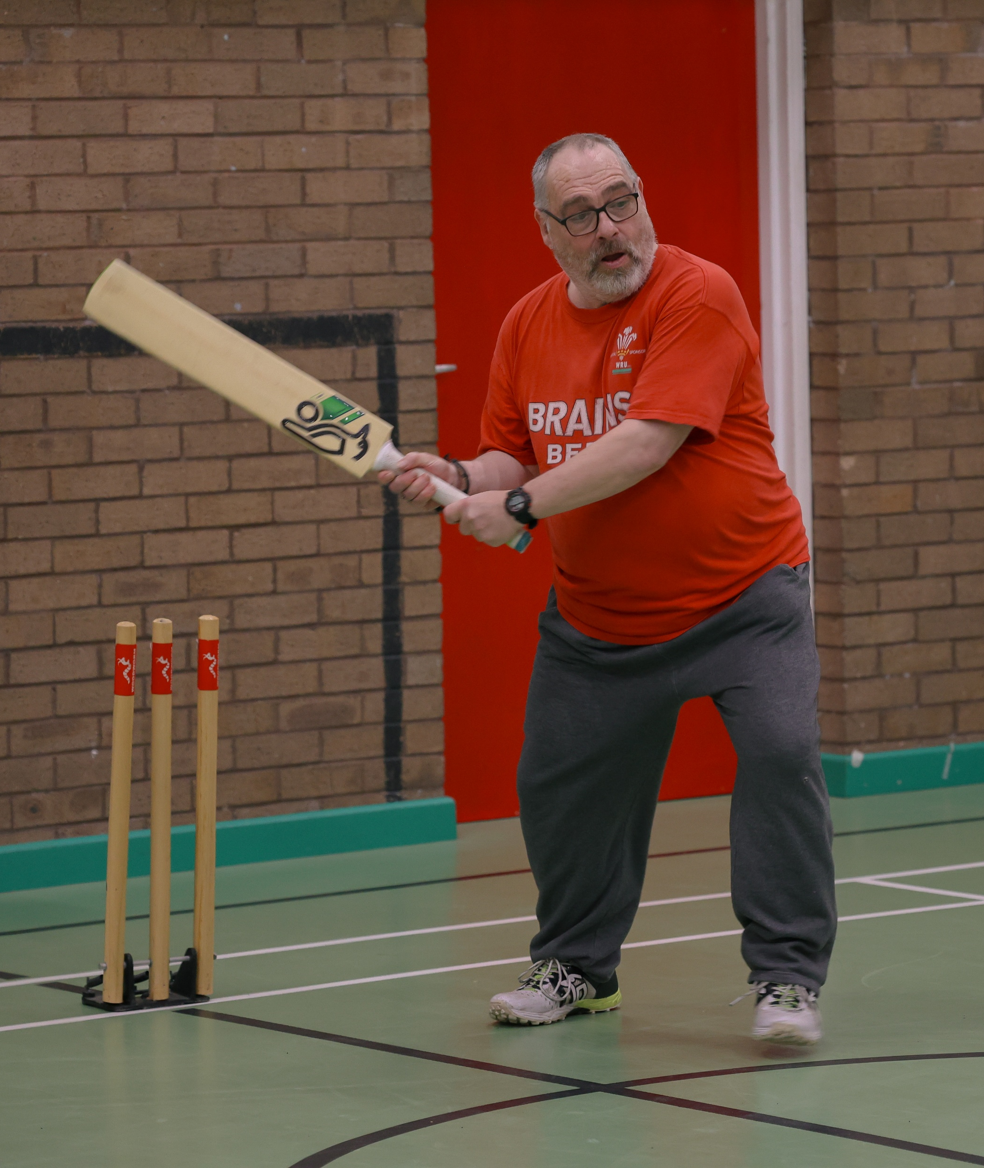
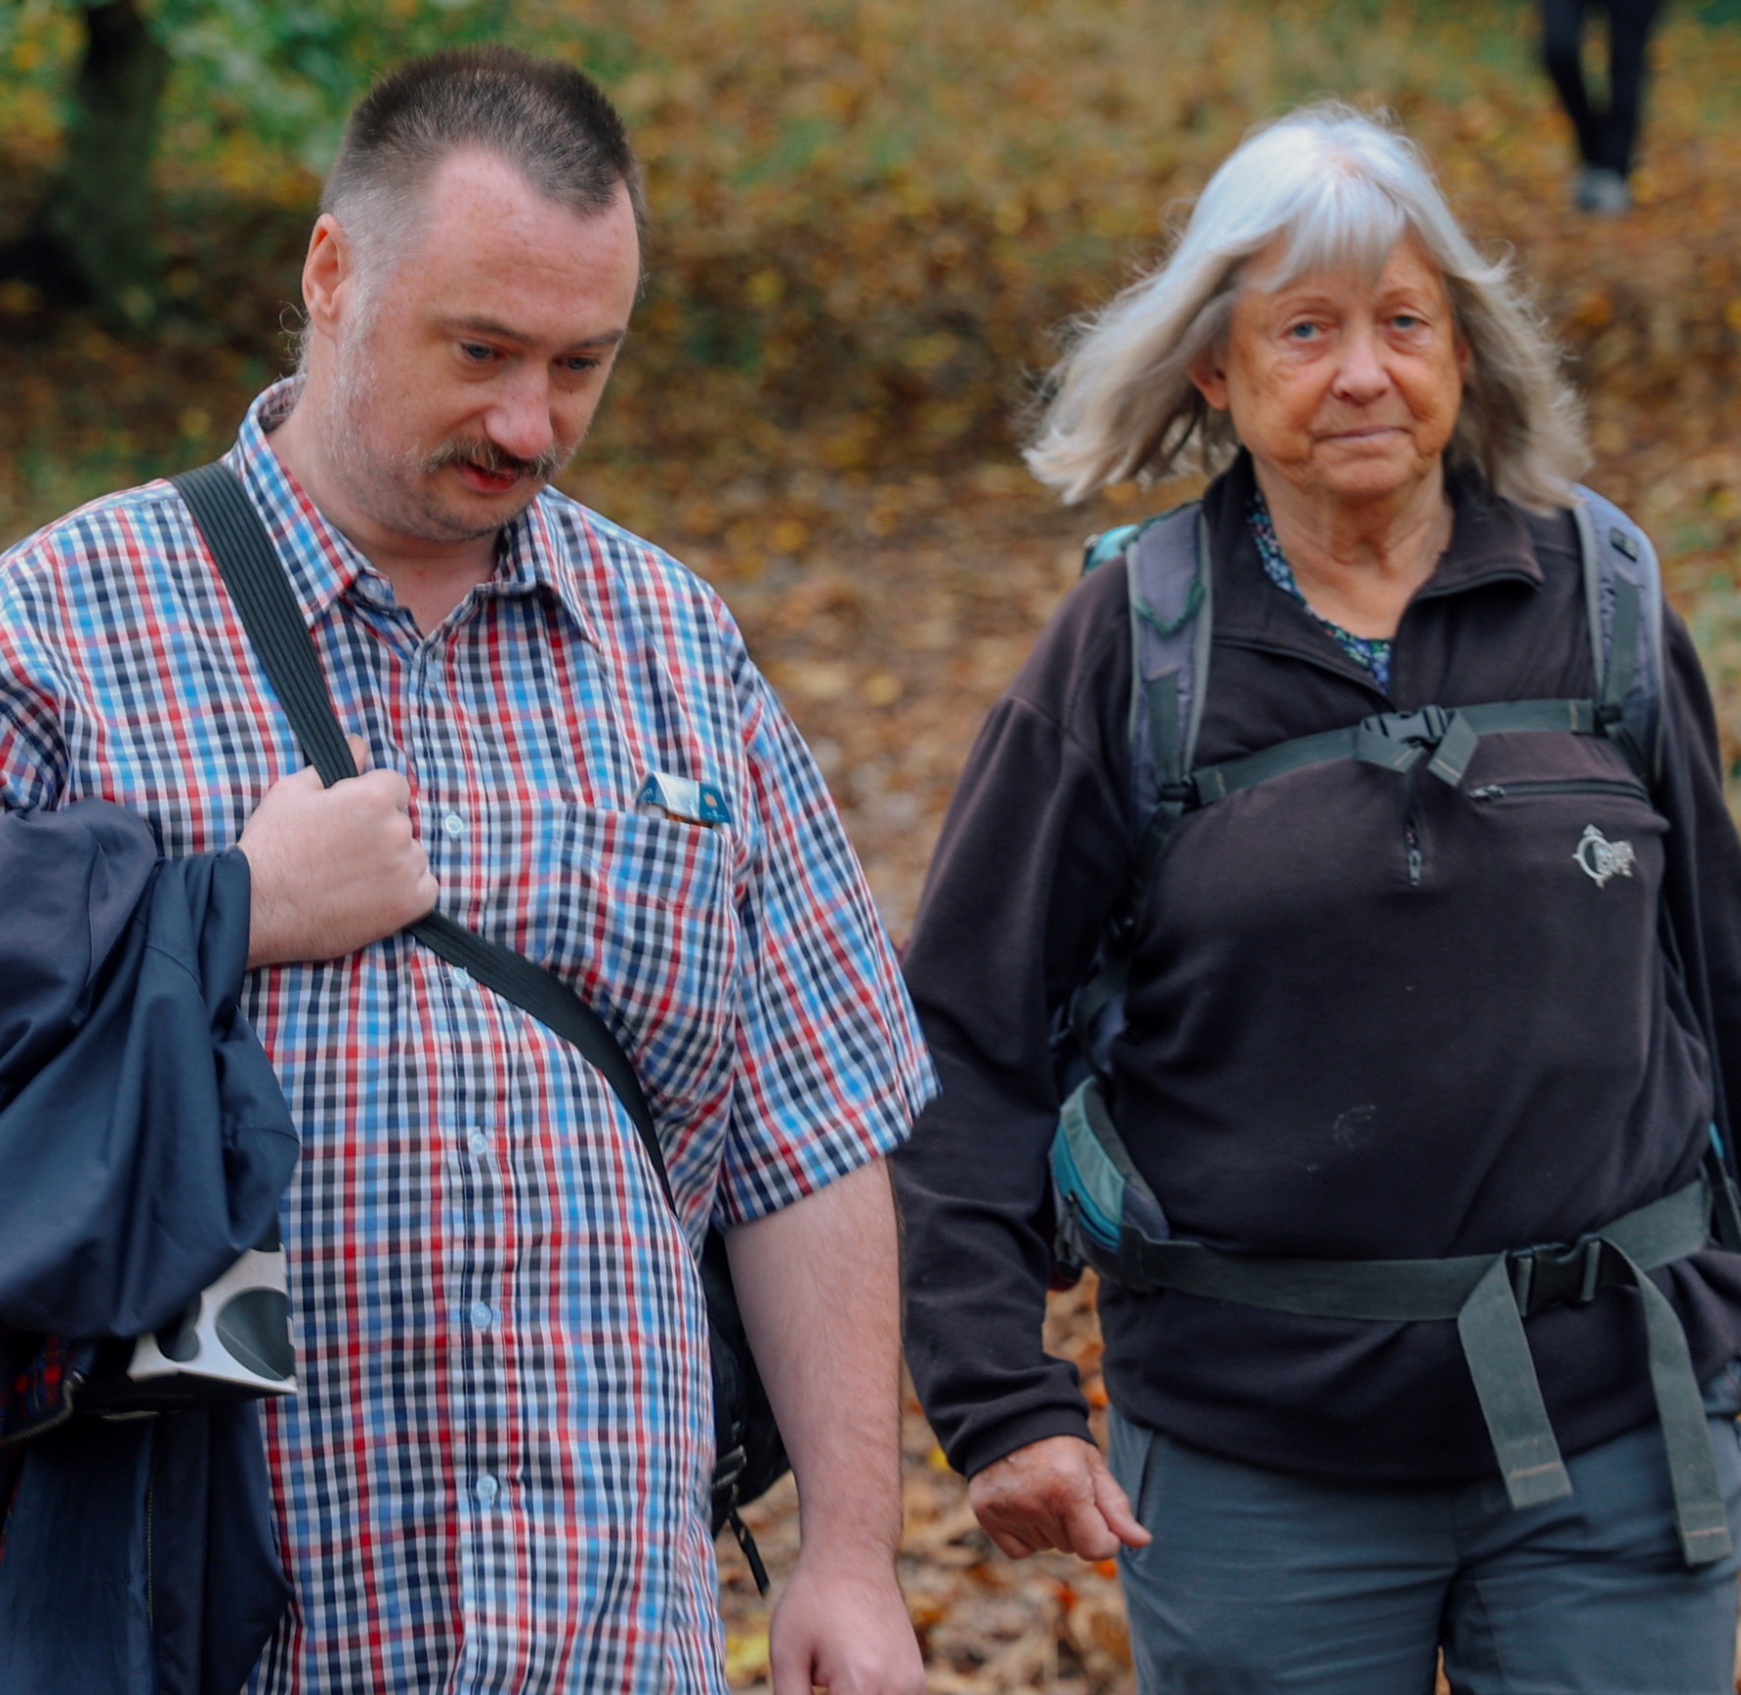
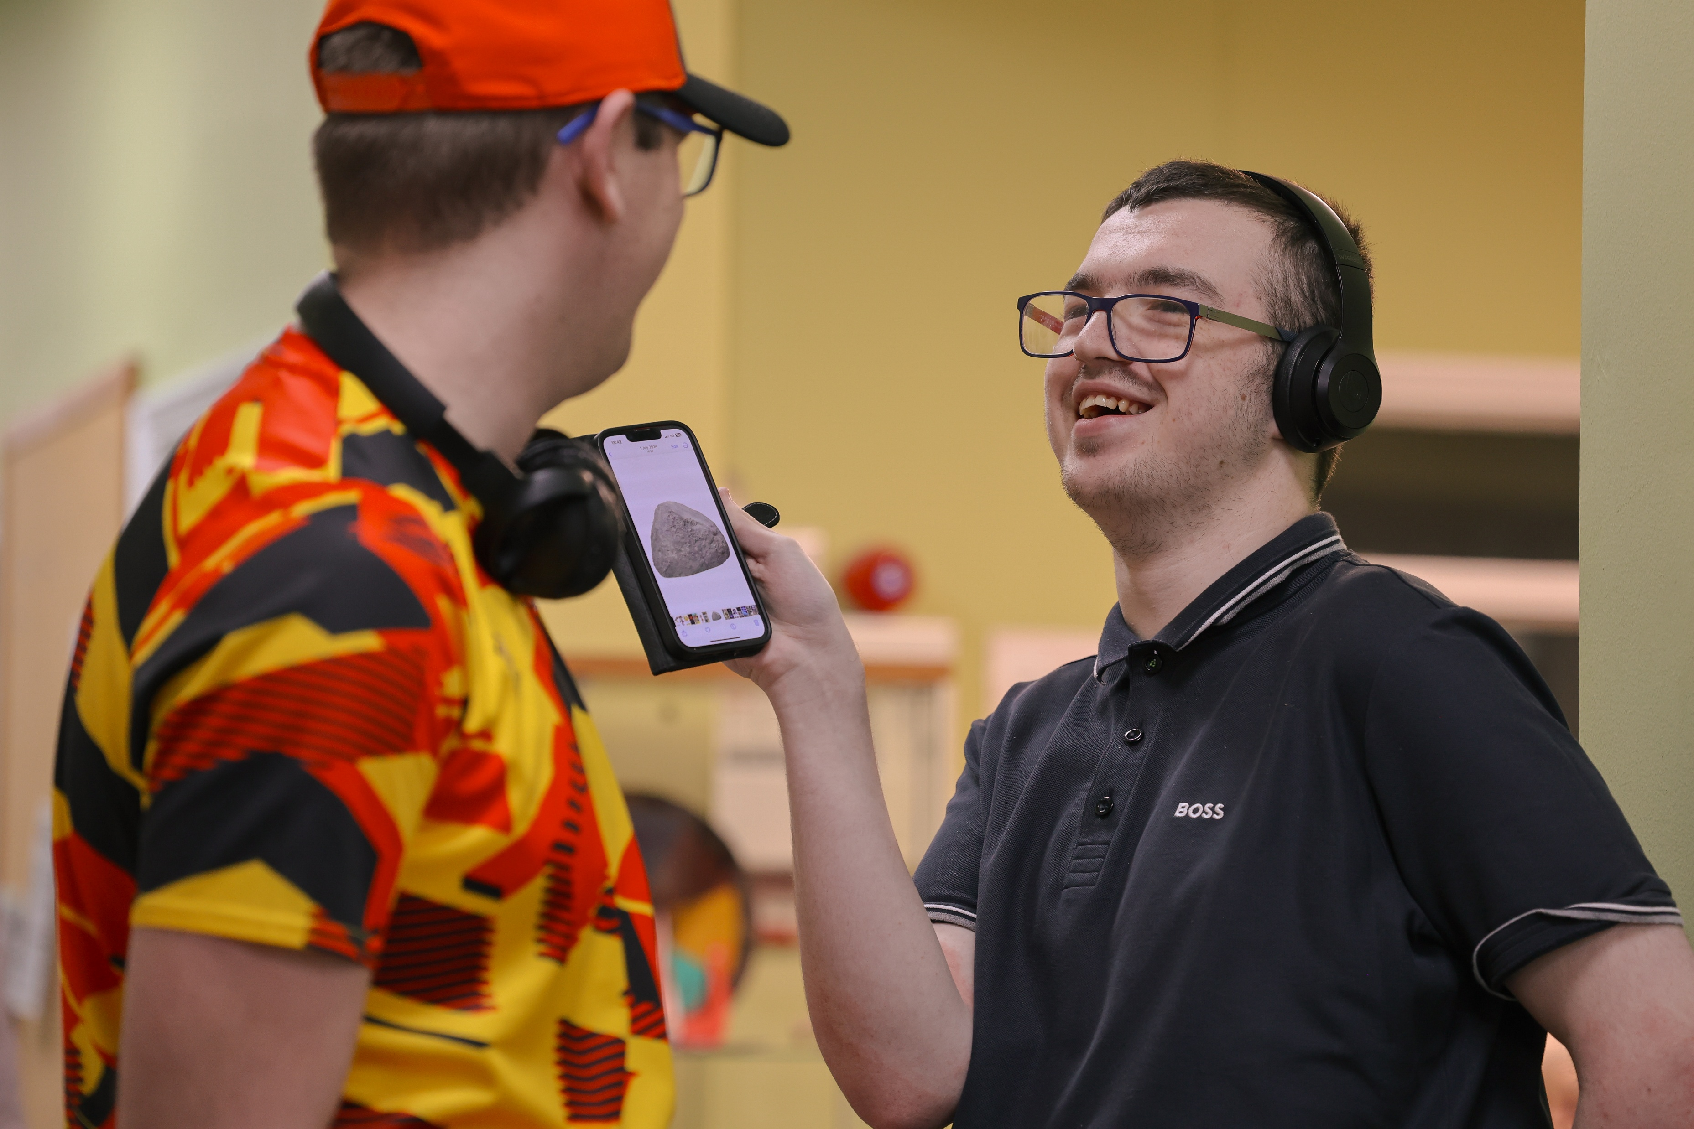
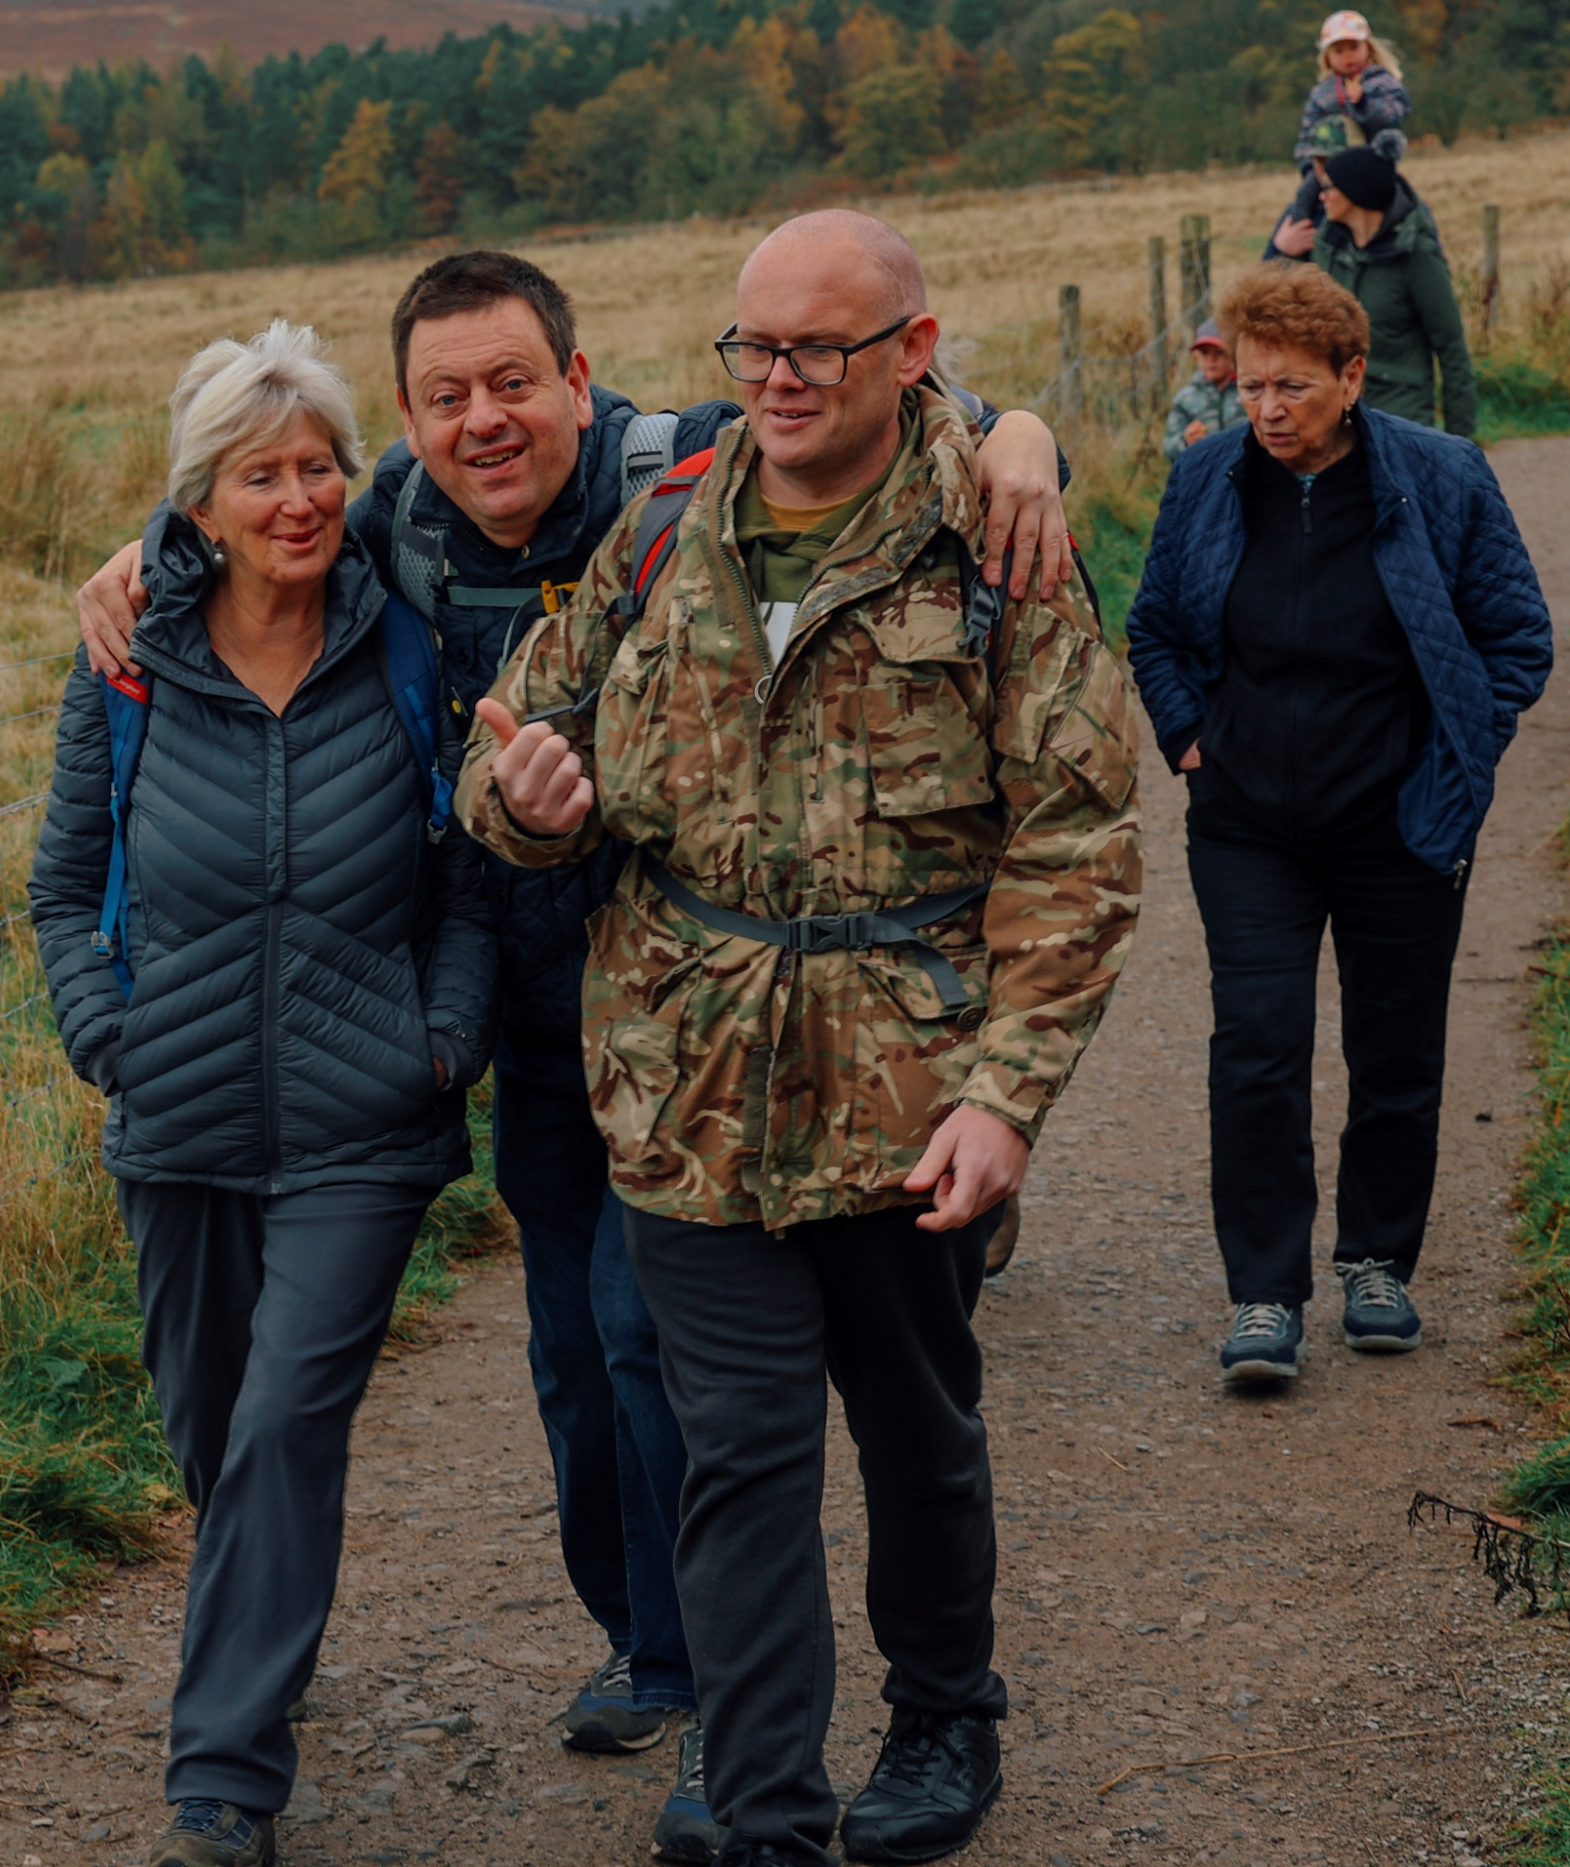
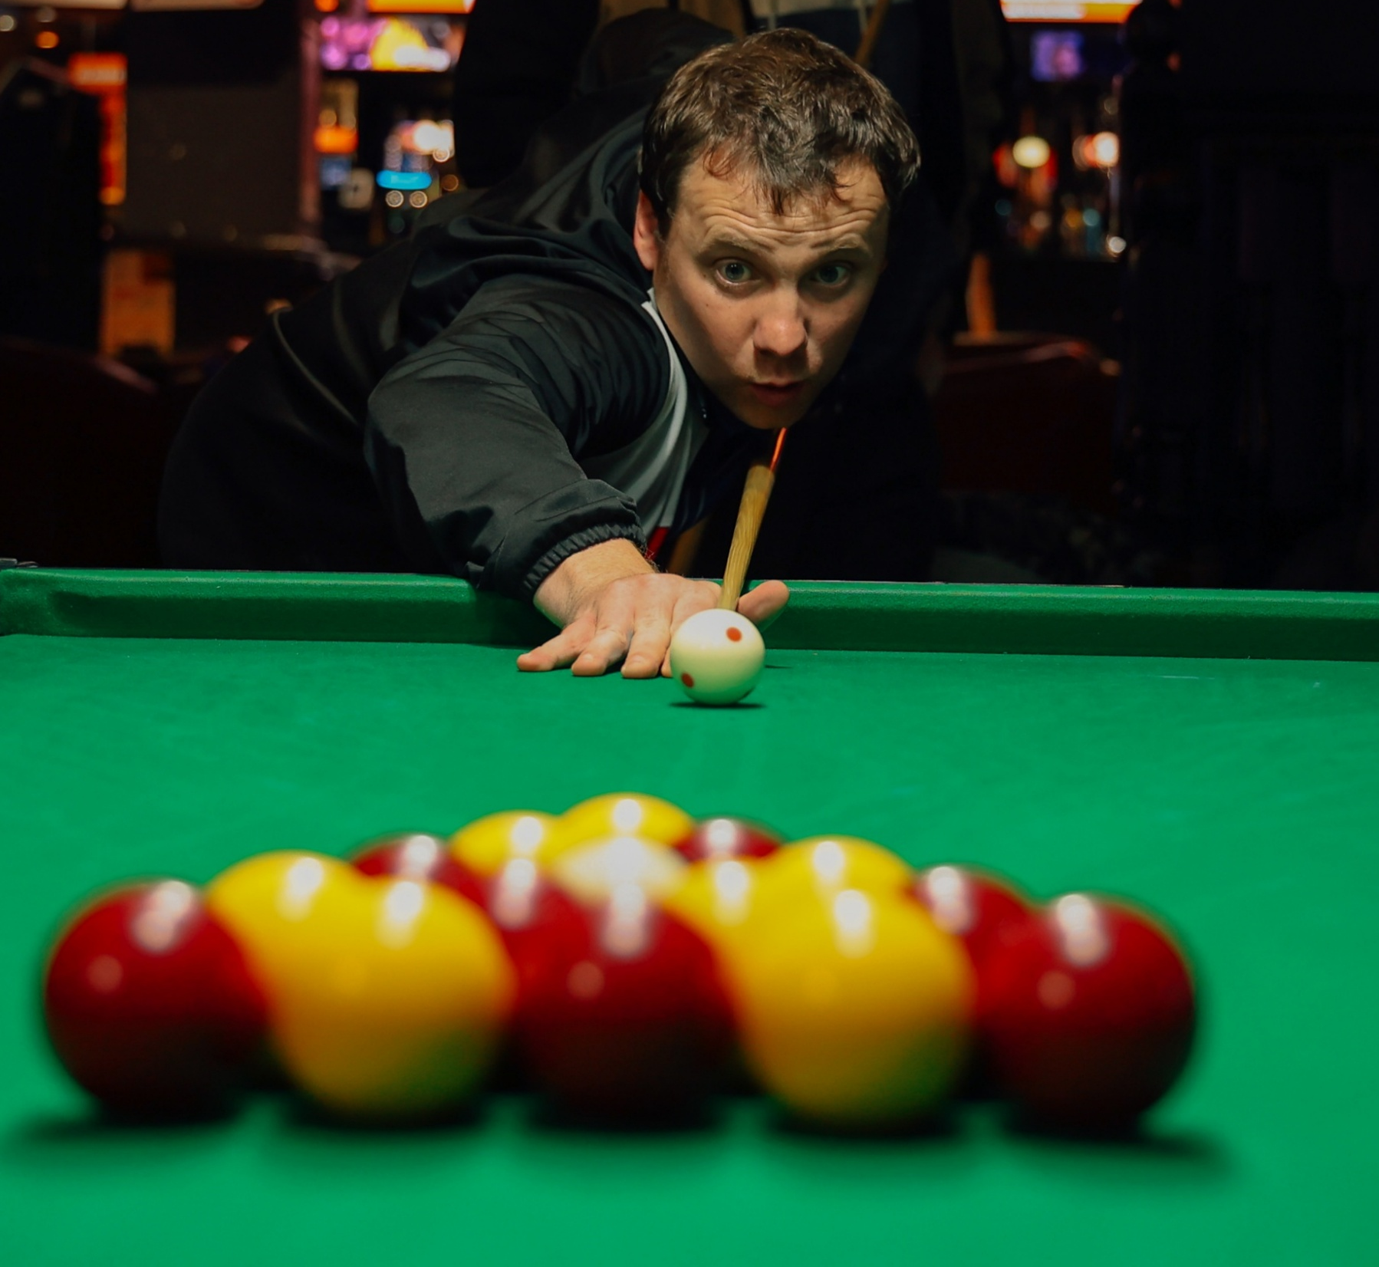
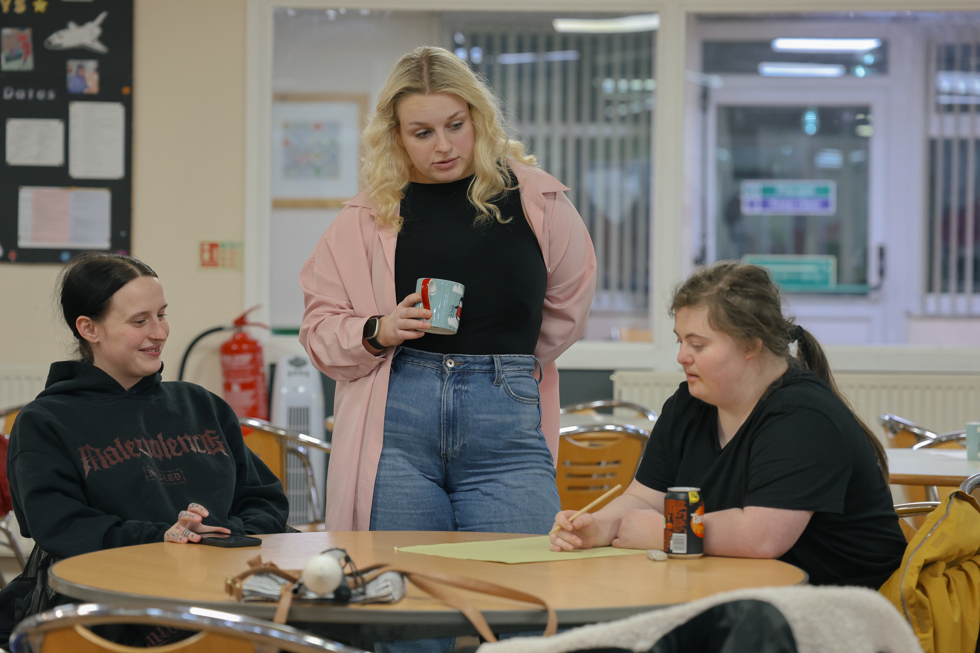
Evening and Weekend Activities

Slide 9
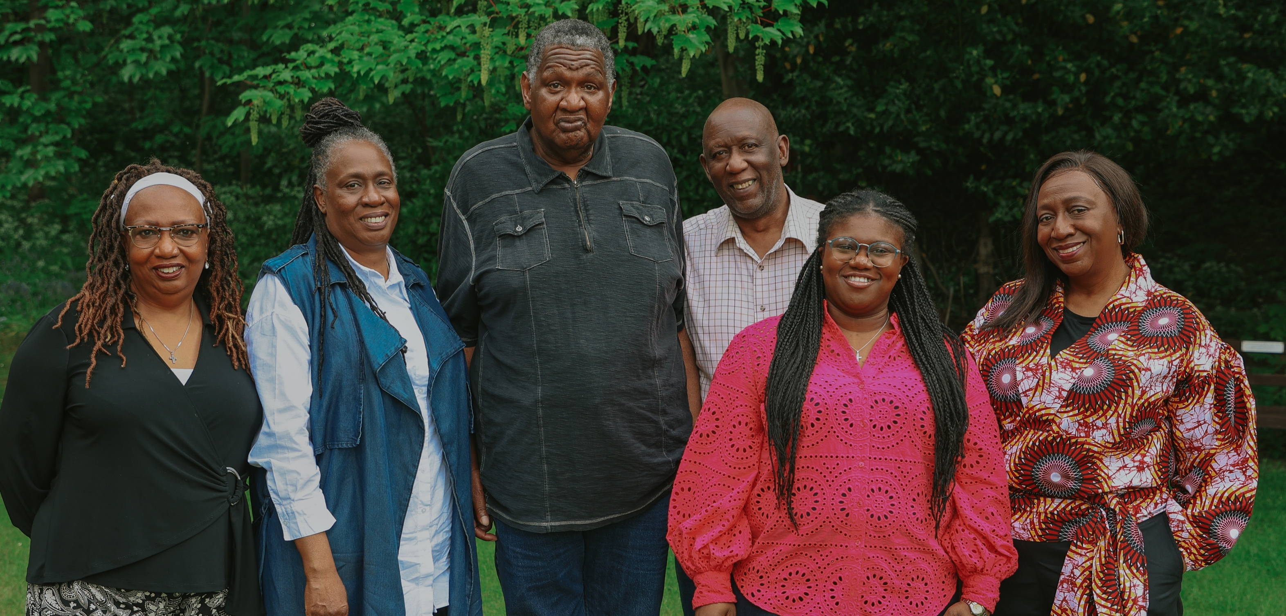
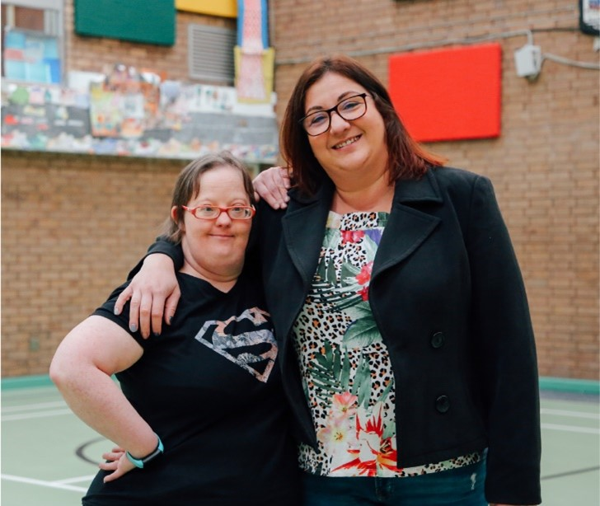
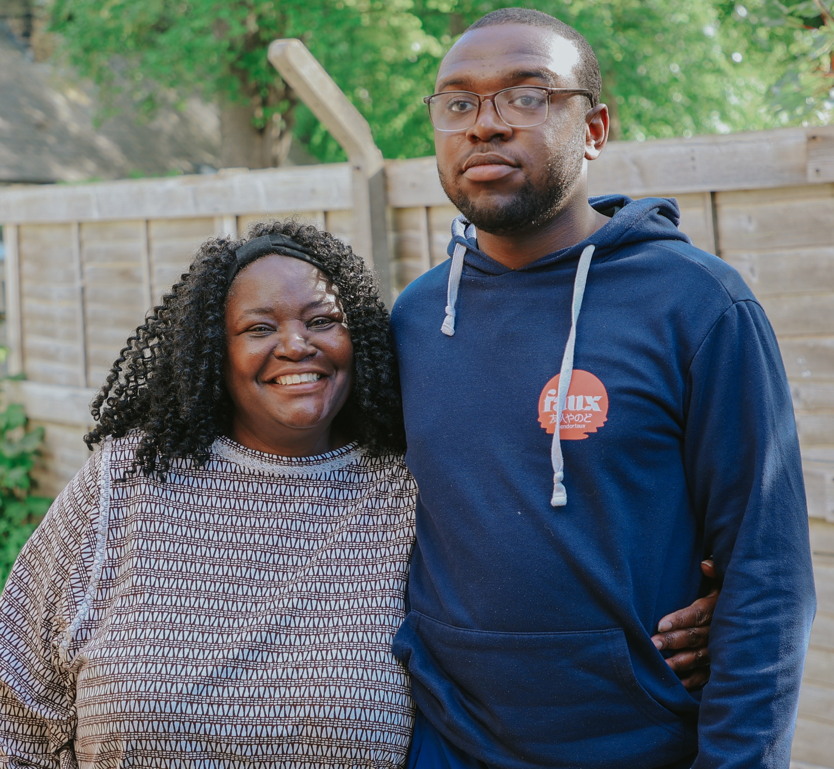
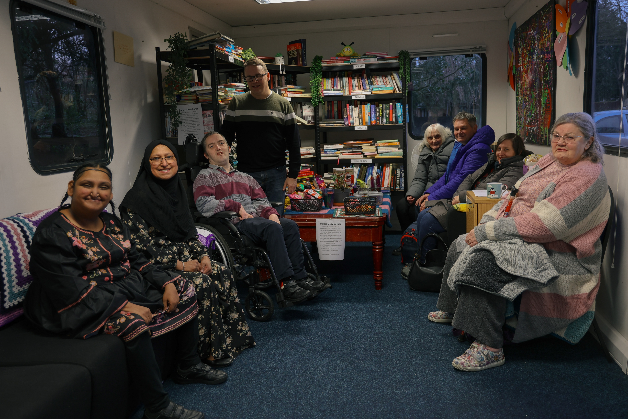
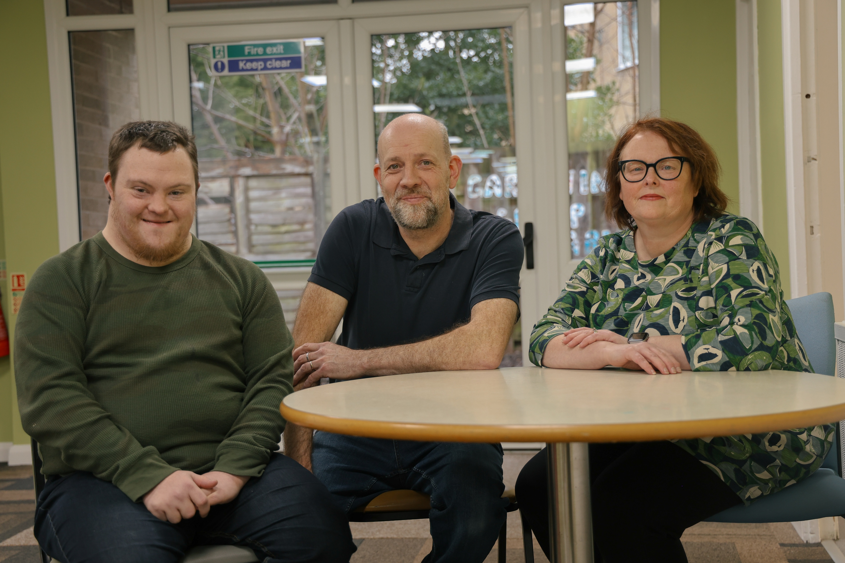
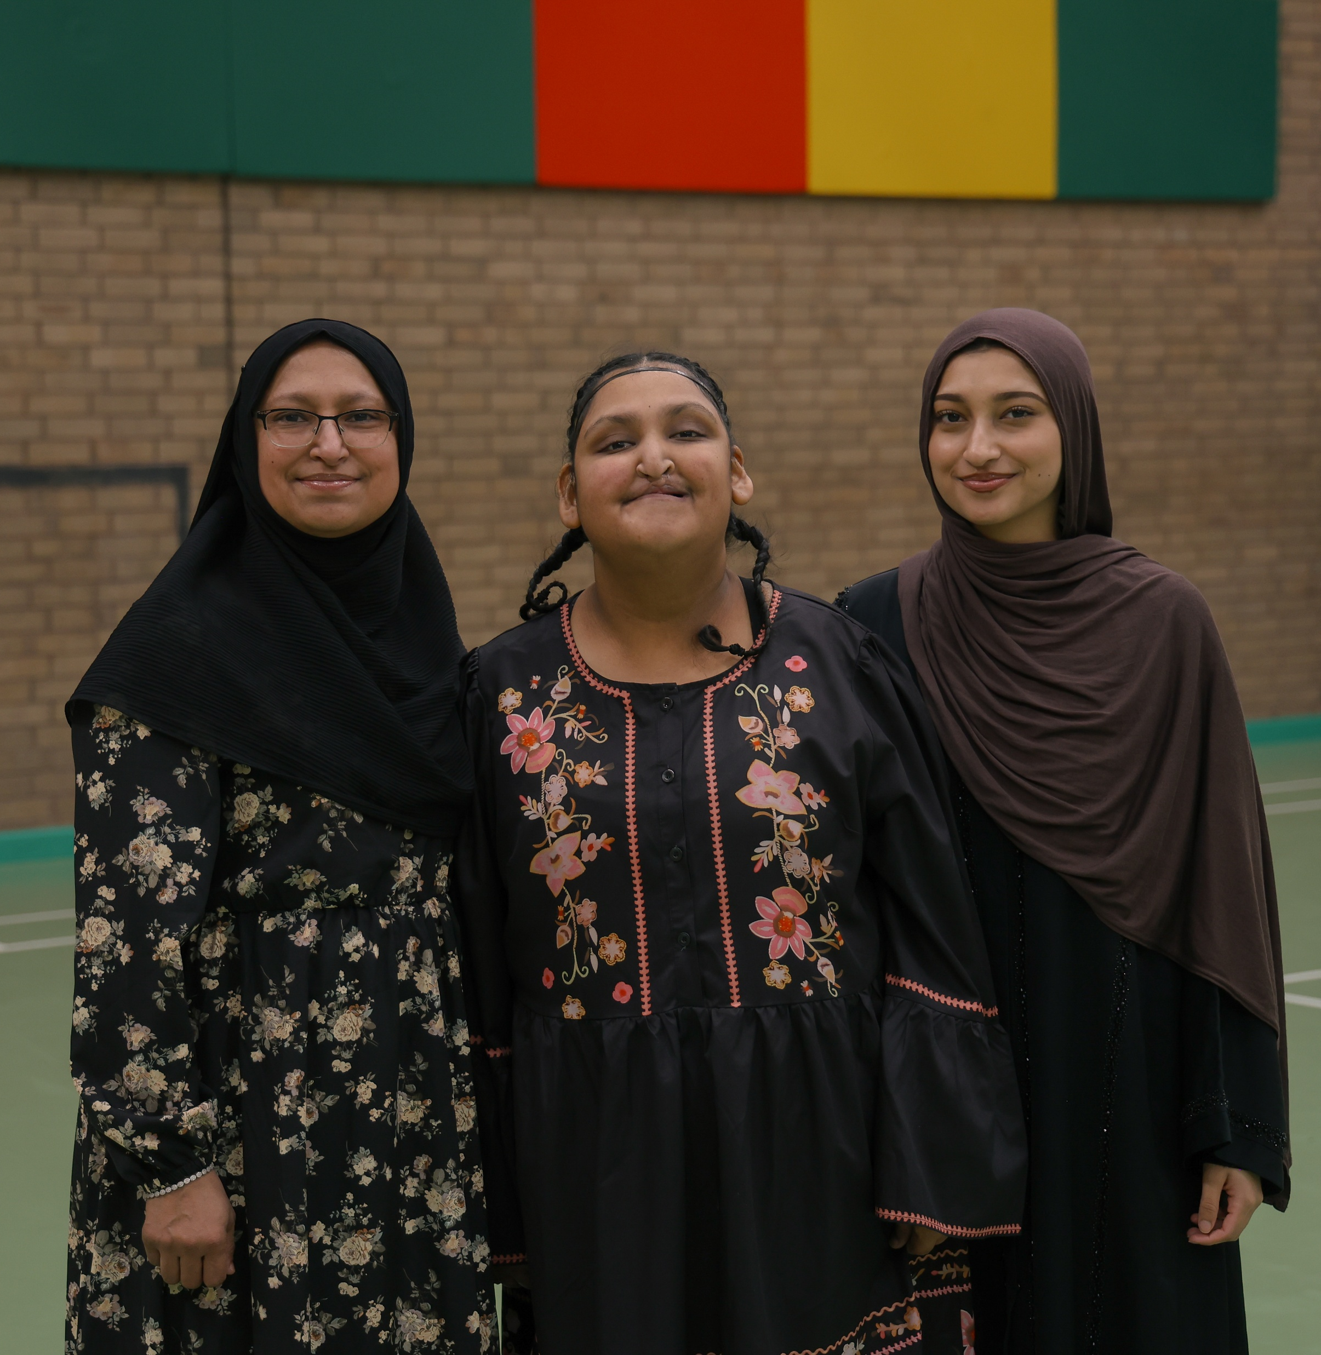
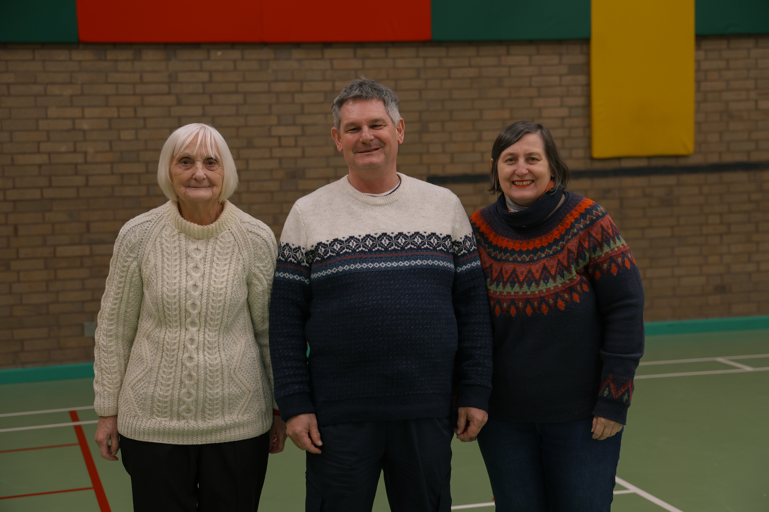
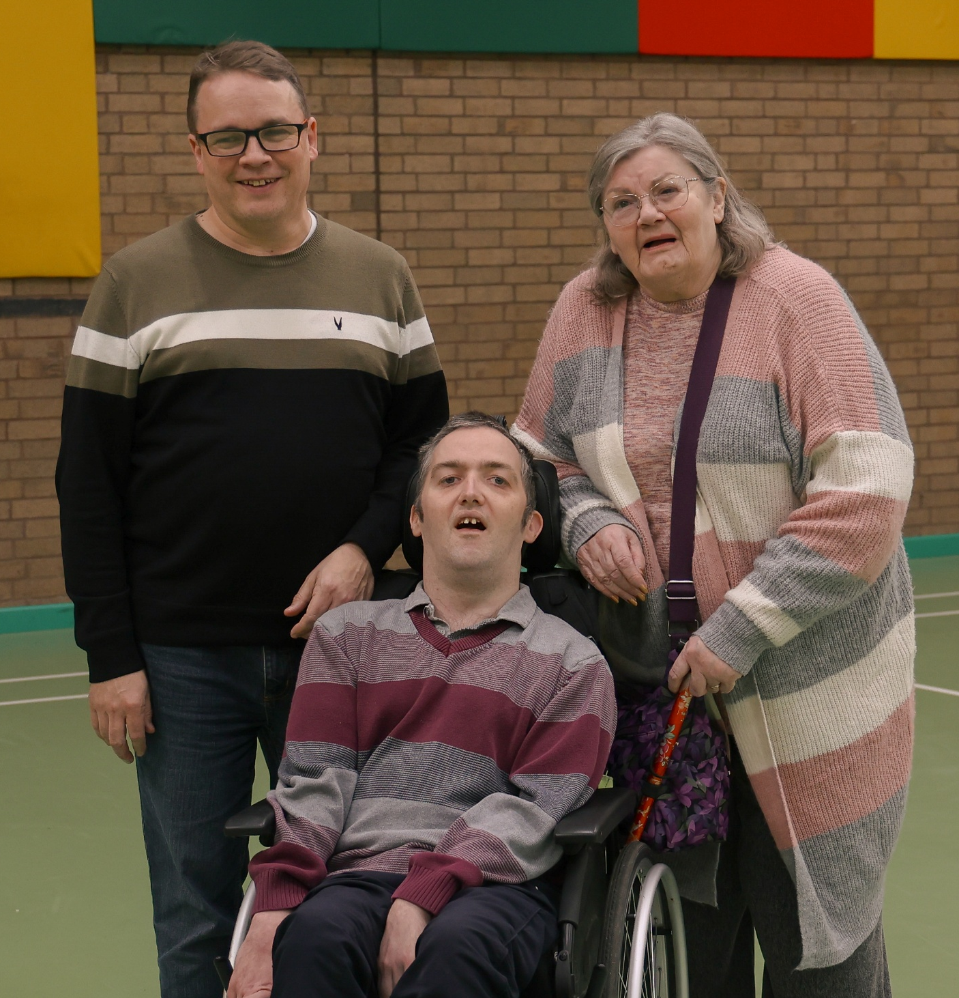
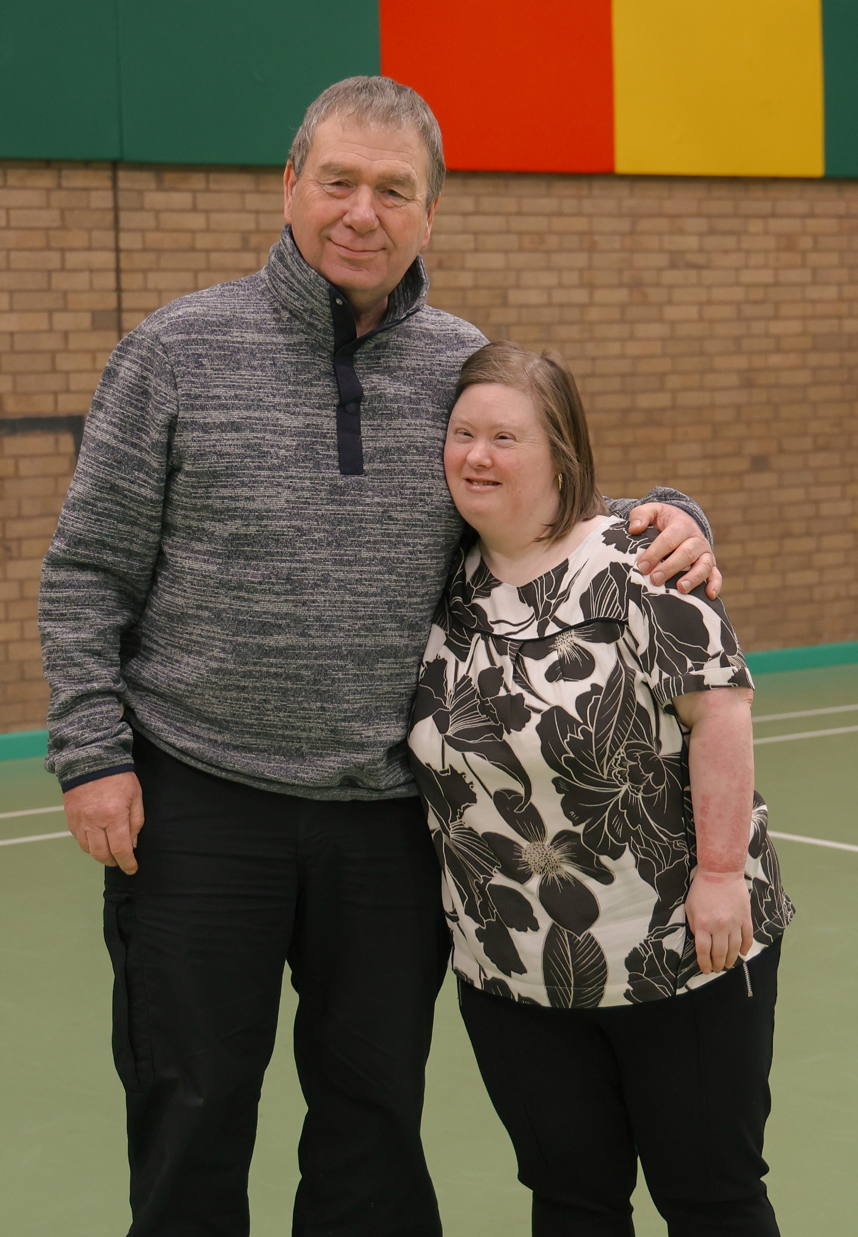
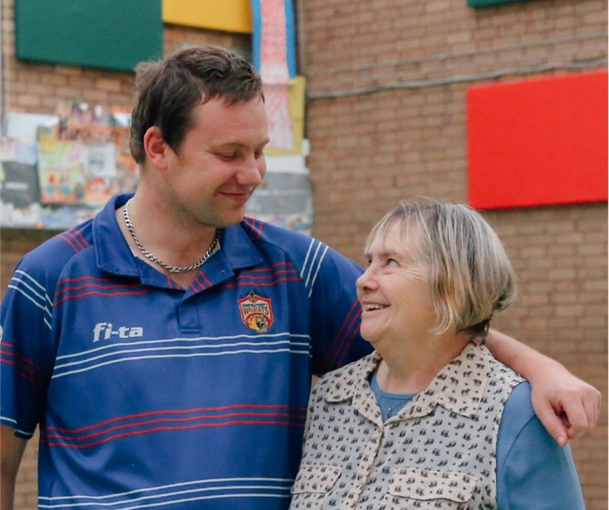
Carers
Services

Slide 10
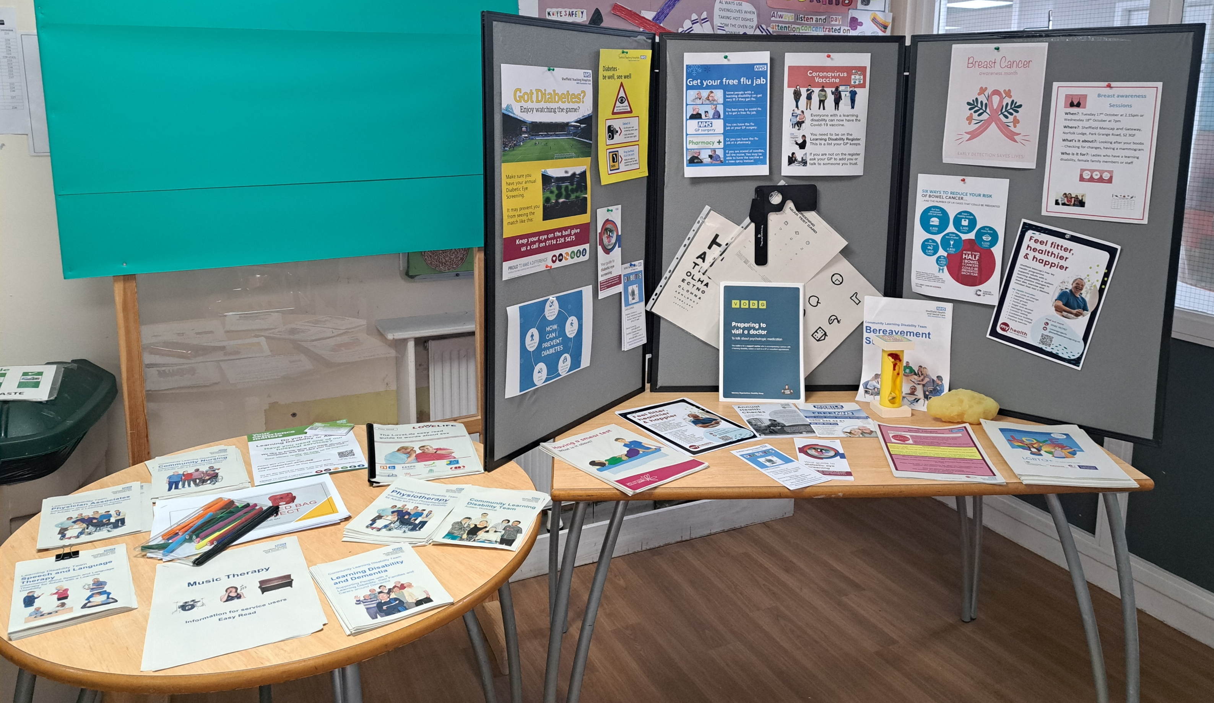
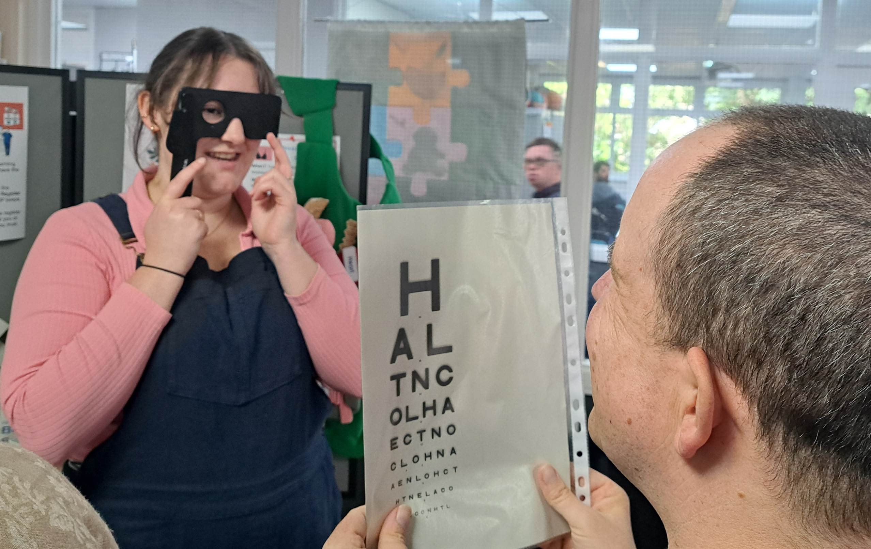
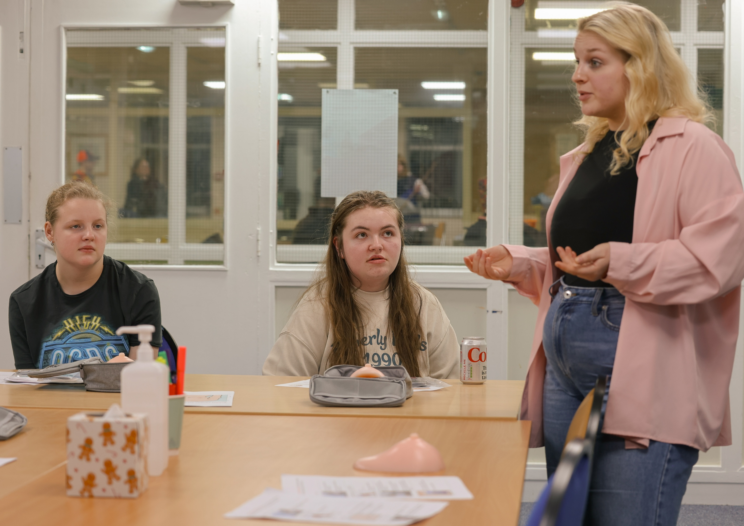
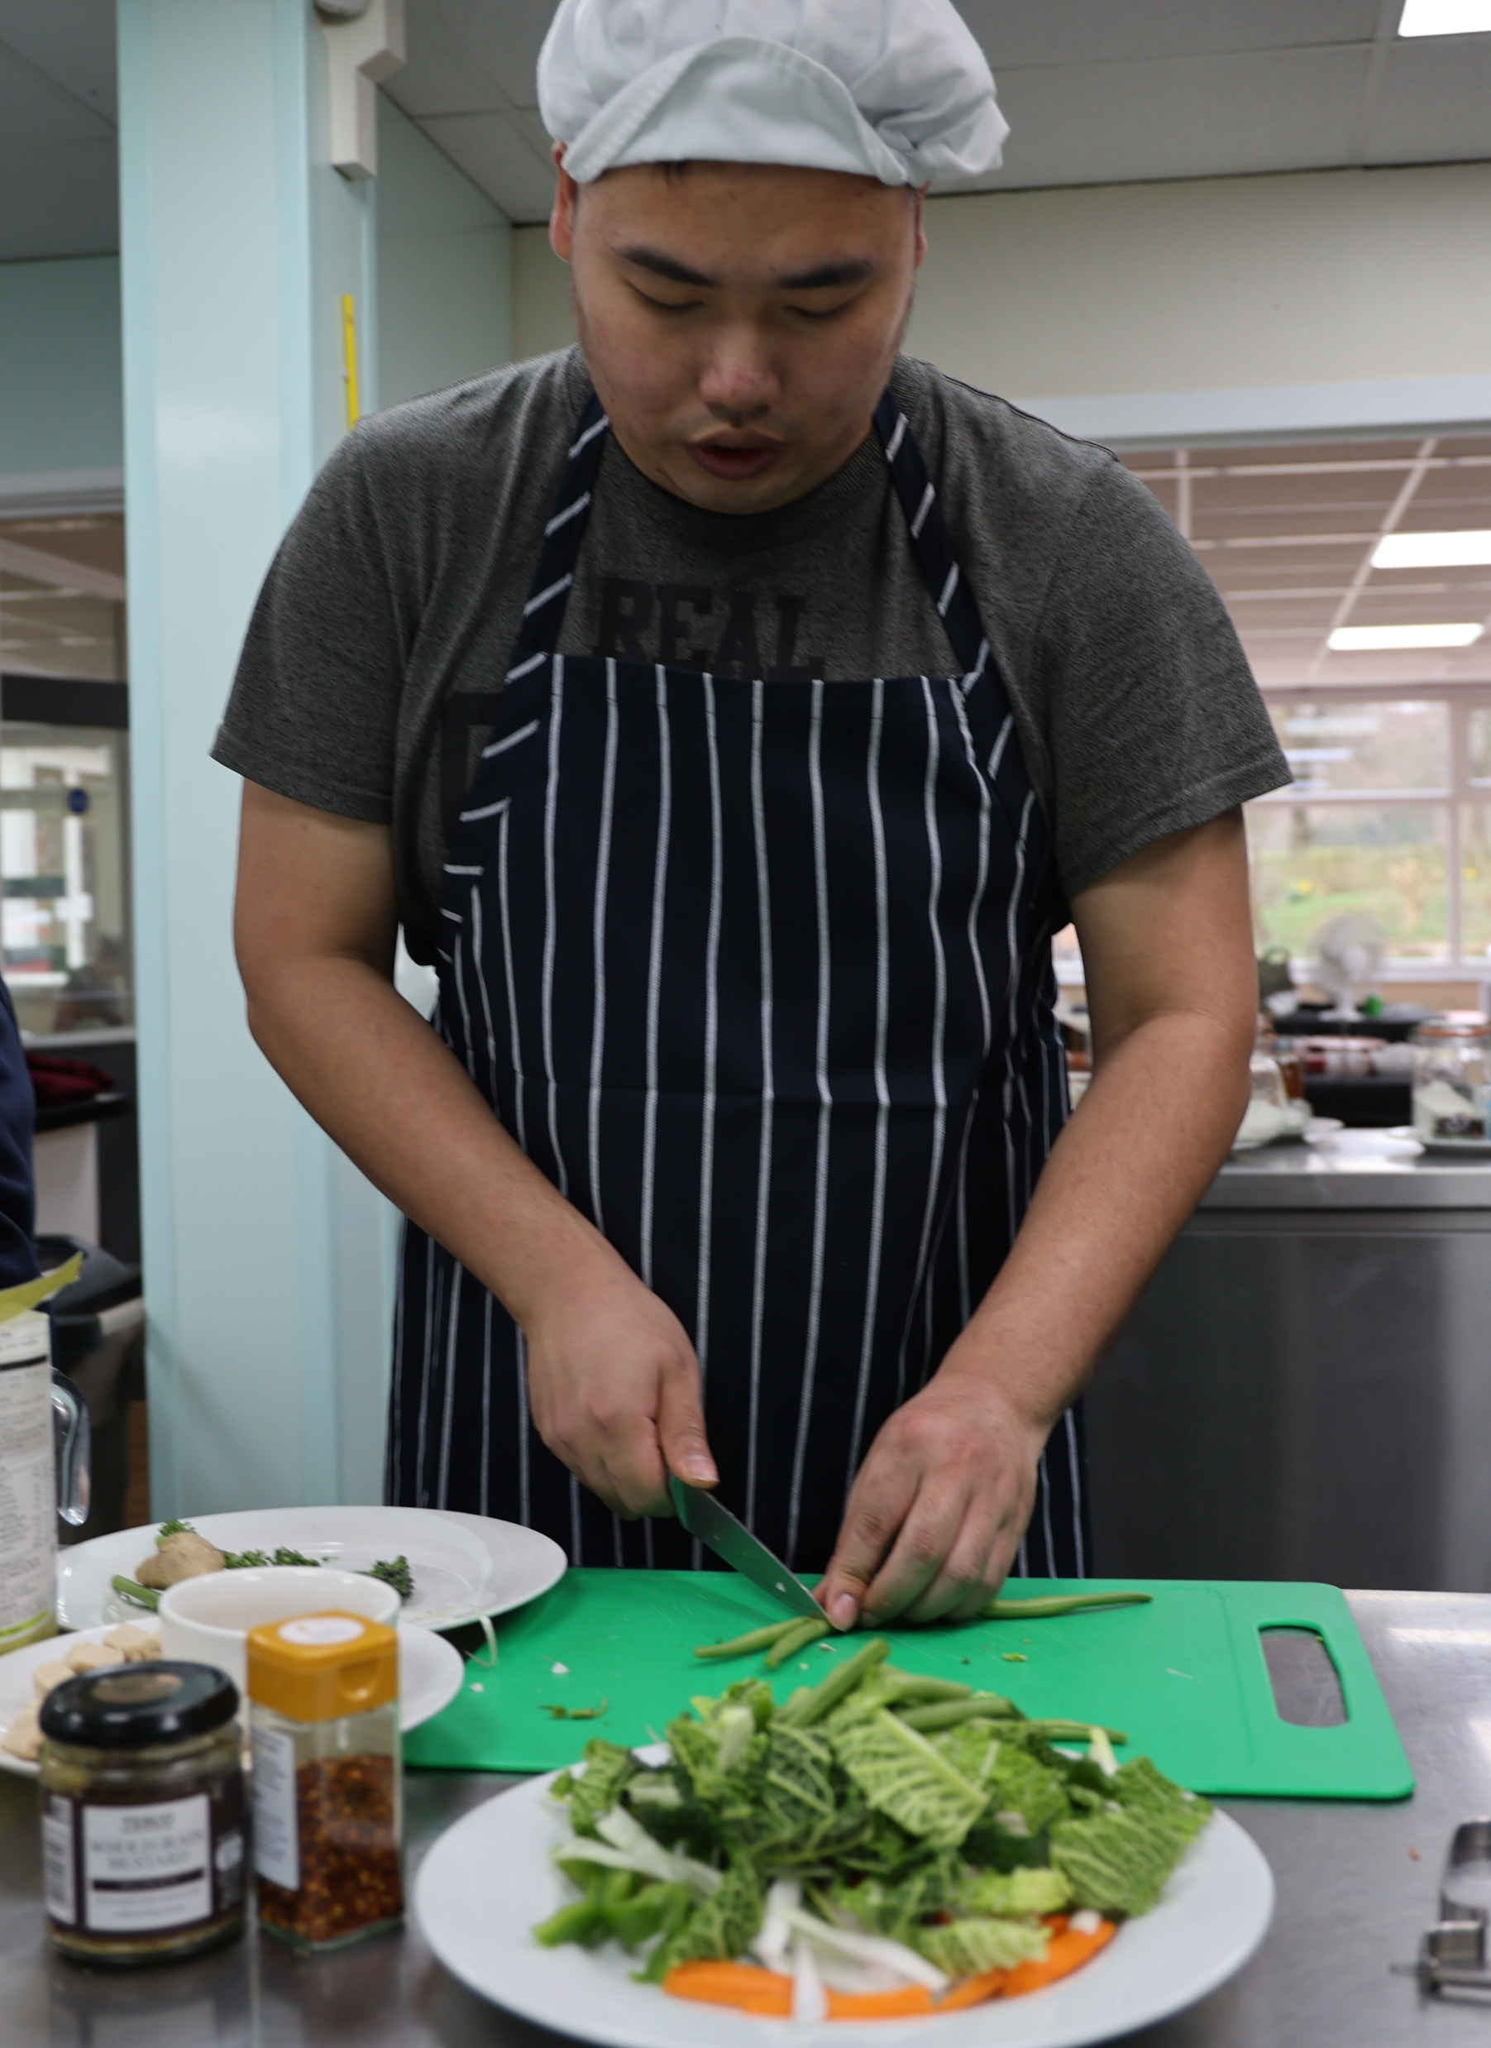
Health
Services

Slide 11
Get involved
Volunteering
We have a range of rewarding and fun voluntary roles across all our services that help you gain valuable experience.
You could support children at a social group, help adults engage in activities including art, sport and cooking or assist at groups out in the community.
Fundraising
We rely on fundraising and donations to keep our services running.
Could you organize a fundraising or sponsored event to support Sheffield’s learning disability community?

Slide 12
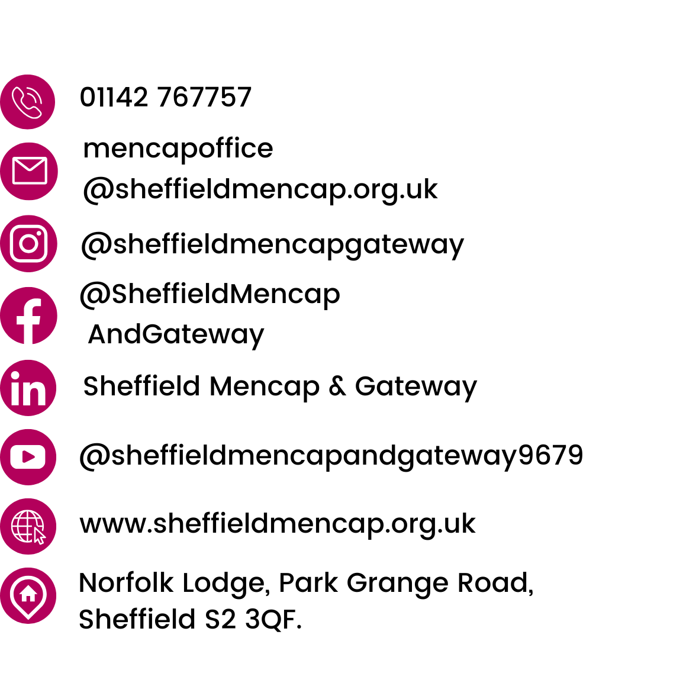
Find out more

